Slide 1
ASSISTANCE FOR MIGRANTS WITH AMPUTATIONS

Slide 2
Through Executive Decree PCM-44-2015, Honduras Declared the Situation of Migrant Populations as a Humanitarian Emergency
DECLARATION OF EMERGENCY
The State of Honduras promotes respect and protection of human rights. Therefore, the government has signed different international agreements and treaties on the matter, as well as other internal regulations ensuring respect for the dignity, human rights and other constitutional guarantees and rights of Hondurans abroad. The State has the duty to protect Hondurans abroad, regardless of their migration status.
The Government of Honduras has assumed responsibility in the migration crisis emergency and has carried out different actions oriented toward coordinating the repatriation, protection, reintegration, follow-up and accompaniment of migrant populations, with a humanitarian approach and with the coordinated participation of all public institutions and institutions of the Honduran society in general.

Slide 3
LEGAL PROTECTION
DECREE Nº106-2013
Constitution of the Republic
Law on Protection of Honduran Migrants and their Families
Article 149
The Secretariat of Health shall coordinate all public actions of the centralized and decentralized bodies of that sector through a national health plan in order to protect those most in need.

Slide 4
Involved Actors
Secretariat of Foreign Affairs and International Cooperation through the Under-Secretariat of Consular and Migration Affairs
Office for Assistance to Returned Migrants (OFAMIR)
Secretariat of Health
Consular Network of Honduras Abroad
Office for the Protection of Honduran Migrants (OPROMH )
National Commission to Support Returned Migrants with Disabilities (CONAMIREDIS)
International Committee of the Red Cross (ICRC)

Slide 5
RETURN PROCESS
Referred by the Consulate of Honduras Abroad
Office for the Protection of Honduran Migrants (OPROMH)
Received at Centres for Assistance to Returned Migrants (CAMR) in Omoa, S.P. S., Belén
A permanent physician provides health care to each individual
Referred to a hospital, if necessary
Follow-up by:
OFAMIR
CONAMIREDIS
ICRC
Office for Assistance to Returned Migrants (OFAMIR)
A permanent psychologist intervenes in crisis situations

Slide 6
TYPES OF CASES RECEIVED
Amputations
Pregnant girls
Injuries
HIV infection
Chronic kidney disease
Fractures
Chronic diseases
Tumours
Cancer
Multiple sclerosis
Congenital malforma-tions
Spinal injuries
Burns
Psychiatric disorders
Psychological disorders

Slide 7
STATISTICS
Returned Migrants
 | Description | 2015 |  | March 2016
 |  | F | M | F | M
1 | Amputations | 2 | 7 | 4 | 7
2 | Chronic diseases | 2 | 6 | 1 | 2
3 | Spine injuries | 0 | 1 | 0 | 0
4 | Psychiatric disorders | 1 | 3 | 0 | 2
5 | Malformations | 0 | 1 | 0 | 0
5 | Fractures | 0 | 4 | 0 | 0
7 | Burns | 0 | 1 | 0 | 1
8 | Total | 5 | 23 | 5 | 12

Slide 8
CHALLENGES
Reducing medical malpractice in amputations;
Extending the period of health care and recovery in the hospital after injuries or operations, before transferring the patients to migration stations or detention centres;
Usually, medical discharges include the approval to travel, even with injuries that have not healed, and this could aggravate the health problem and lead to amputation;
Not interrupting the medical treatment while the patient is still in a migration station or detention centre;
The need for real information.

Slide 9
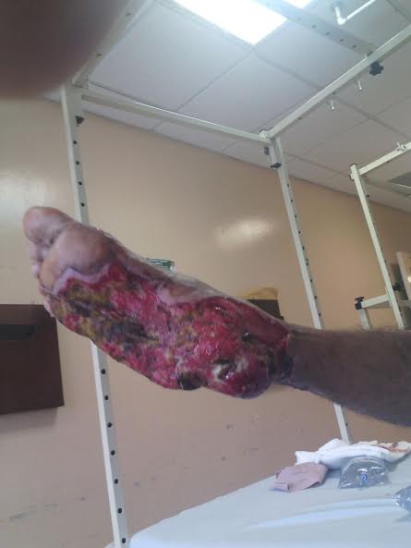
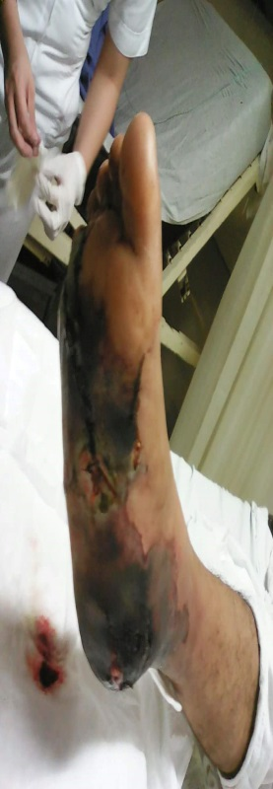
EXAMPLES OF CASES RECEIVED

Slide 10
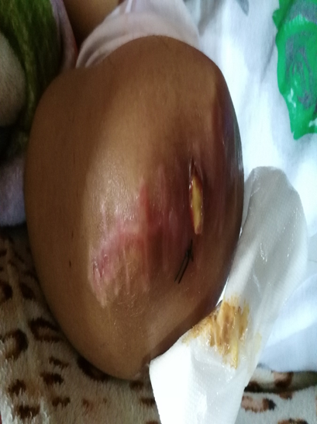
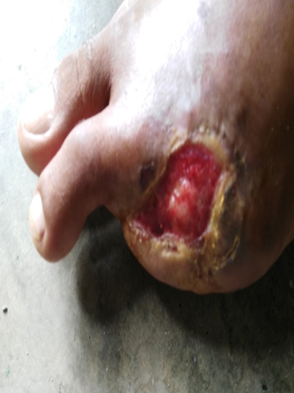
EXAMPLES OF CASES RECEIVED

Slide 11
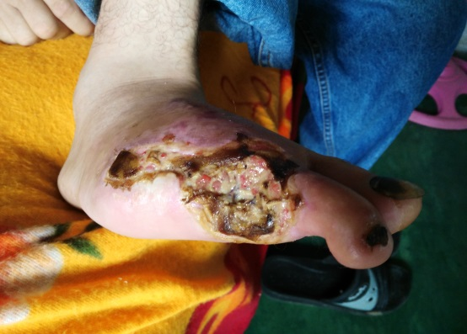
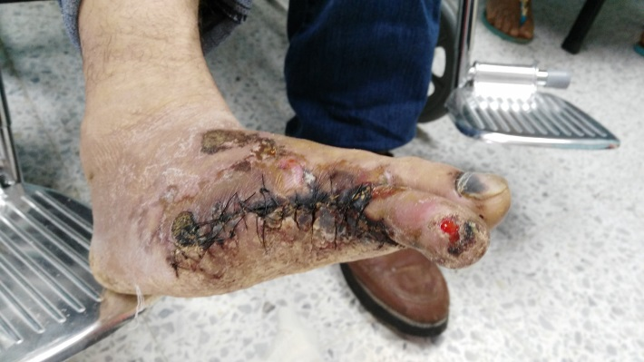
EXAMPLES OF CASES RECEIVED

Slide 12
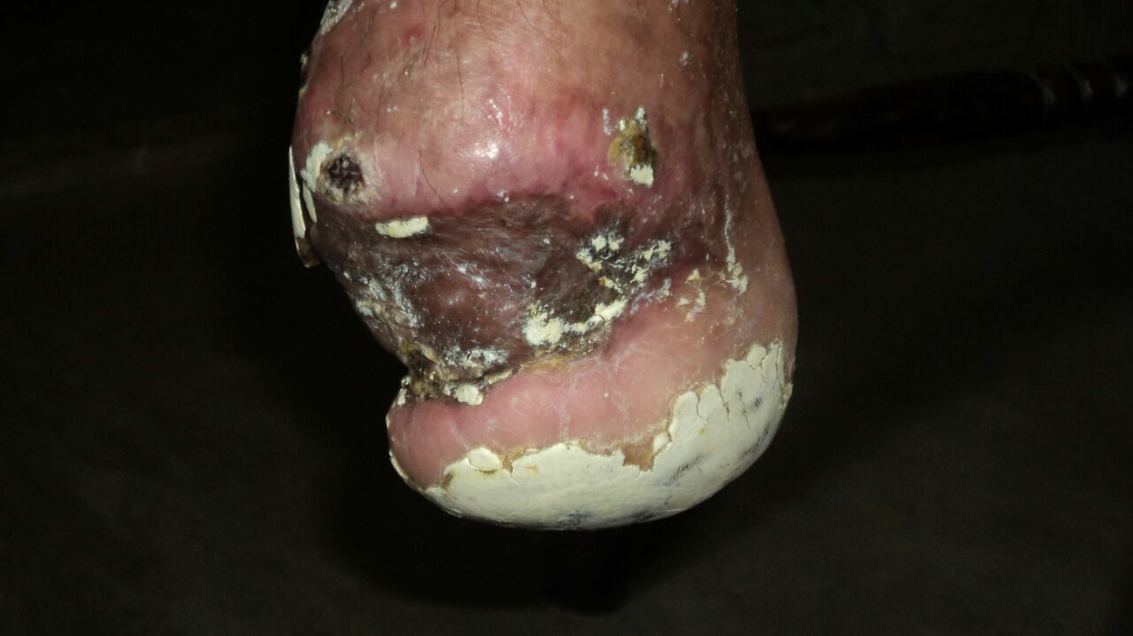
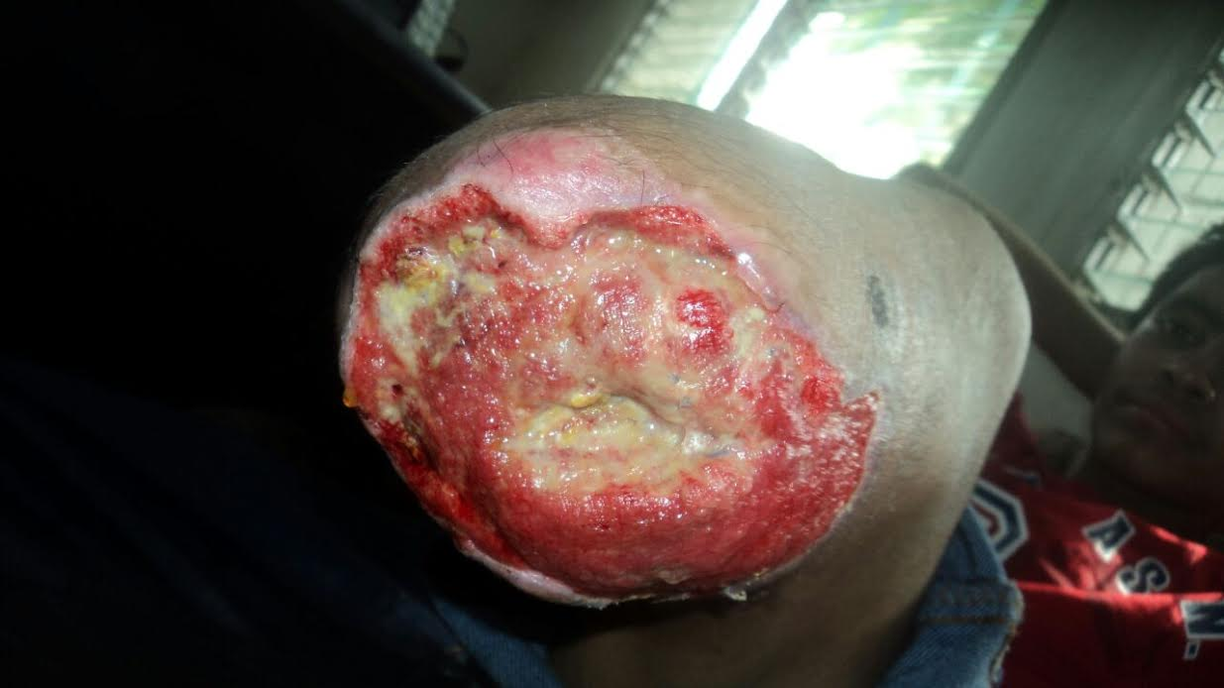
EXAMPLES OF CASES RECEIVED

Slide 13
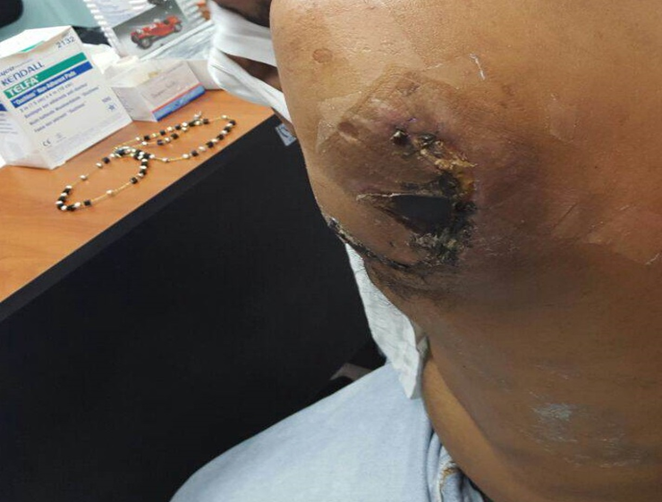
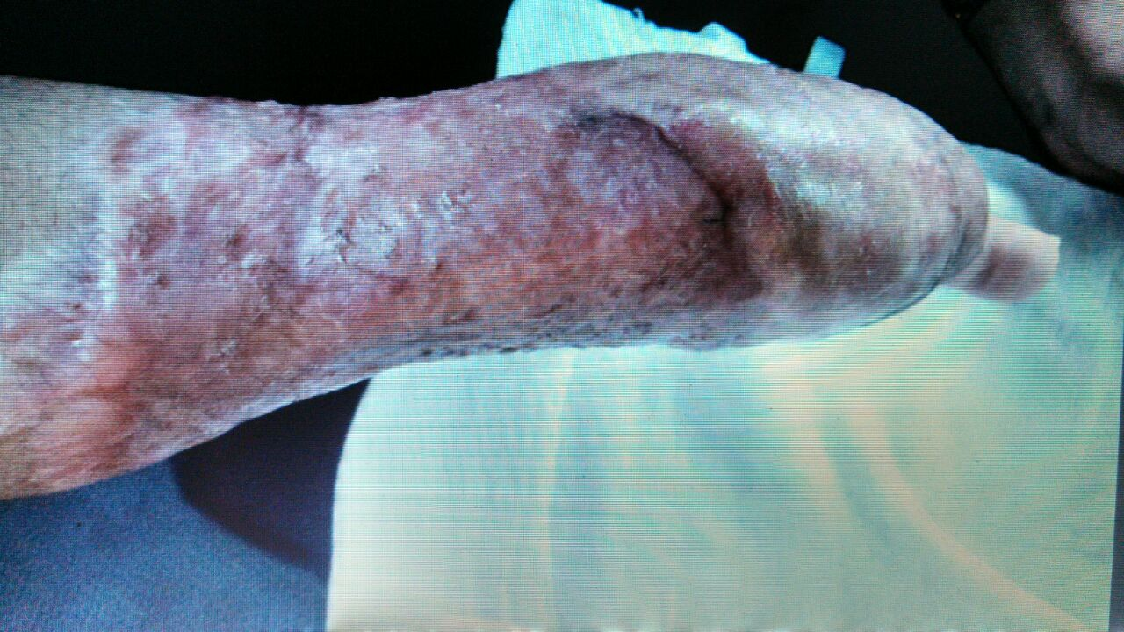
EXAMPLES OF CASES RECEIVED

Slide 14
Thanks for your attention.

