Slide 1


Slide 2
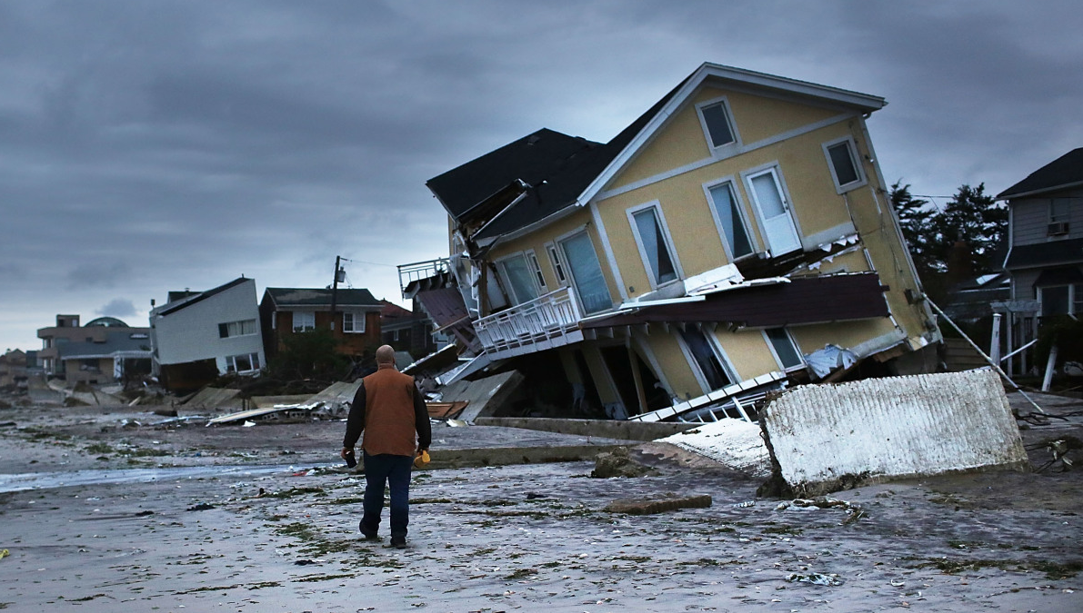
Why MICIC?
Recent humanitarian crises
(Libya, Japan, Yemen, US/Sandy)
Number of migrants affected
Specific vulnerability condition
No international protection system in place
Respect, protect, fulfill human rights
Take responsibility: States
Take responsibility: all others

Slide 3
MICIC Initiative Process
State-led, multistakeholder
Broad consultative process
Reports, newsletters, webinars, repository of practices
MICIC Initiative
Guidelines
June
2016

Slide 4
Scope of MICIC Initiative
Which Crises?
Conflict
Natural Disaster
Which Migrants?
In country when crisis hits
Temporarily or permanently
Regardless of legal status
Which Phases?
Pre-Crisis
Emergency
Post-Crisis

Slide 5
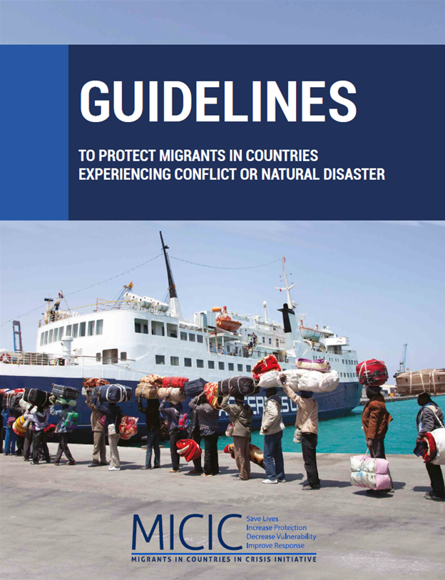
MICIC Initiative Guidelines
Voluntary and non-binding
Principles
Guide all actions
Guidelines
Targeted suggestions to shape policies
Practices
Technical and operational advice
http:\\micicinitiative.iom.int

Slide 6
Principles
Save lives
Respect, protect, fulfill human rights
Take responsibility: States
Take responsibility: all others
Be guided by humanitarian principles
Empower migrants
Communicate positively about migrants
Act at all levels
Cooperate
Learn and innovate

Slide 7
Guidelines: Preparedness
Track information on conflicts and natural disasters
Collect and share information
Empower migrants
Incorporate migrants in preparedness and response

Slide 8
Guidelines: Preparedness
Plan with migrants
Communicate effectively
Coordinate
Build capacity and learn lessons

Slide 9
Guidelines: Emergency Response
Communicate widely and often
Facilitate movements to safety
Assist without discrimination
Refer special cases
Relocate and evacuate

Slide 10
Guidelines: Post-crisis Action
Address migrants’ needs
Support host communities

Slide 11
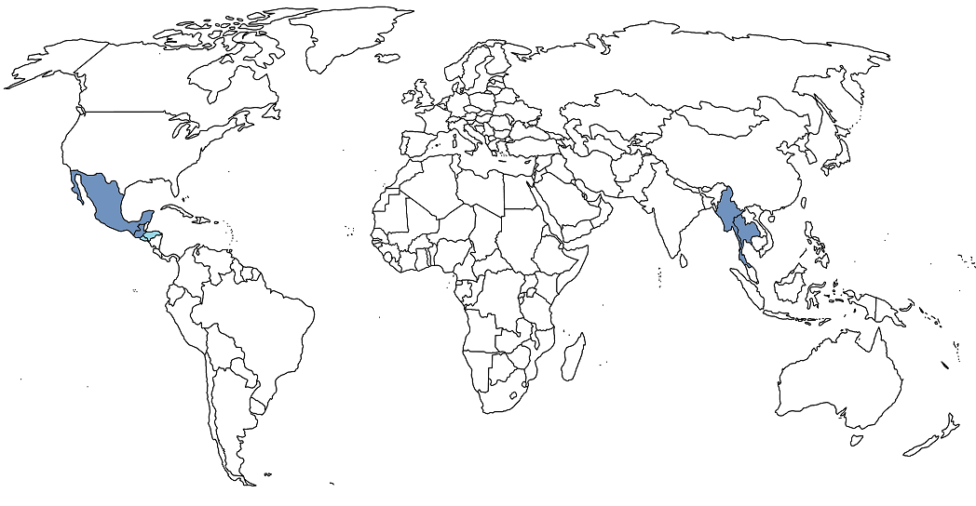
The Capacity Building Program
Countries of origin
Host countries
Myanmar & Thailand
Guatemala & Mexico
El Salvador & Honduras

Slide 12
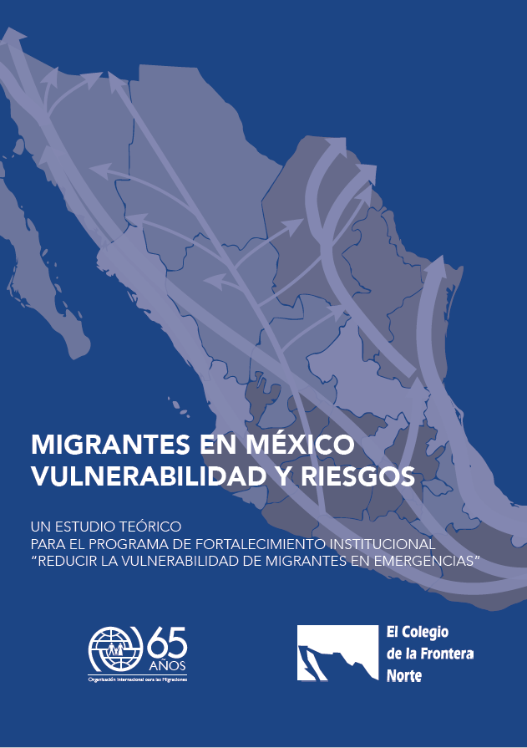
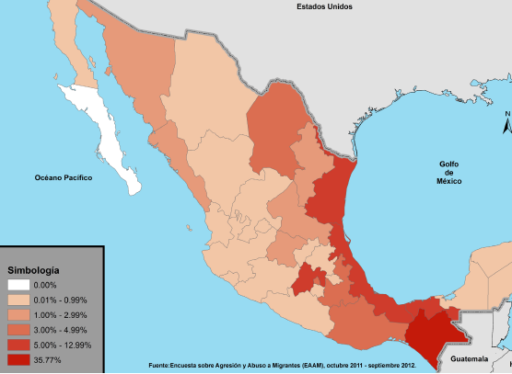
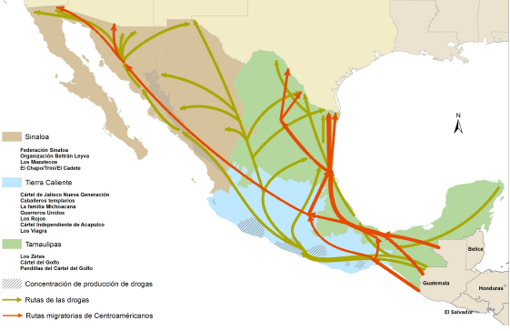
Research Component
RESEARCH COMPONENT
micicinitiative.iom.int/research

Slide 13

Country of Origin: E-learning
Nationals abroad
Potential crises
Tracking migrants
Raising migrants’ awareness
Communicating in emergencies
Contingency planning
Supporting migrants’ evacuation
Supporting return and recovery

Slide 14
Country of Origin: Smartphone app
Registration & contact details
Online consular services
Scheduling an appointment
GPS search of closest consulate
Travel advisory
Emergency warnings and alerts
Options for assistance

Slide 15
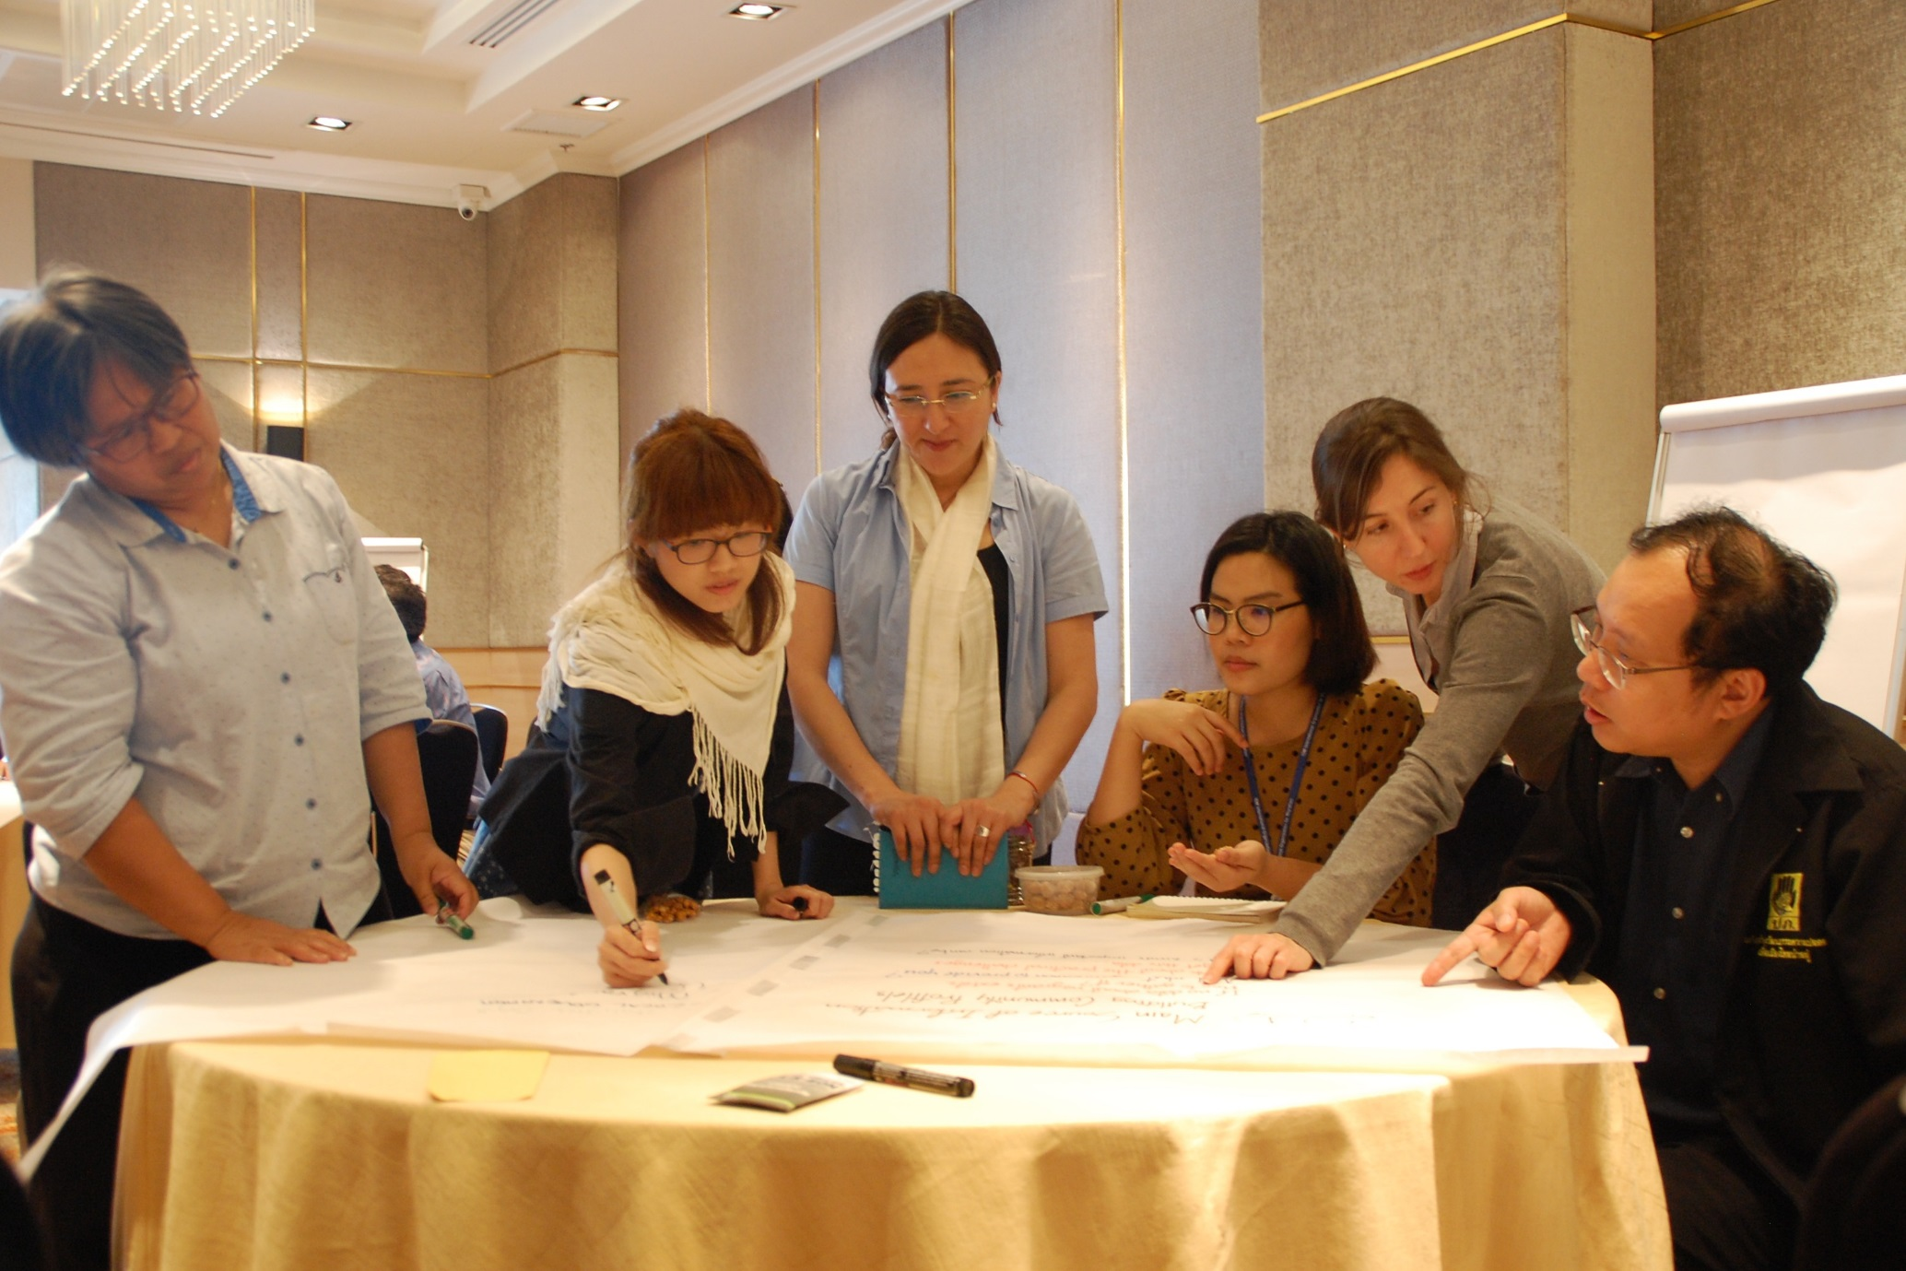
Host Country: Training Course
Migration context
Migrants’ conditions of vulnerability
Frameworks, institutions and actors
Understanding migrant groups
Migrants in emergency management
Communicating with migrants
Planning for migrants’ evacuation
Assisting migrants in emergencies

Slide 16
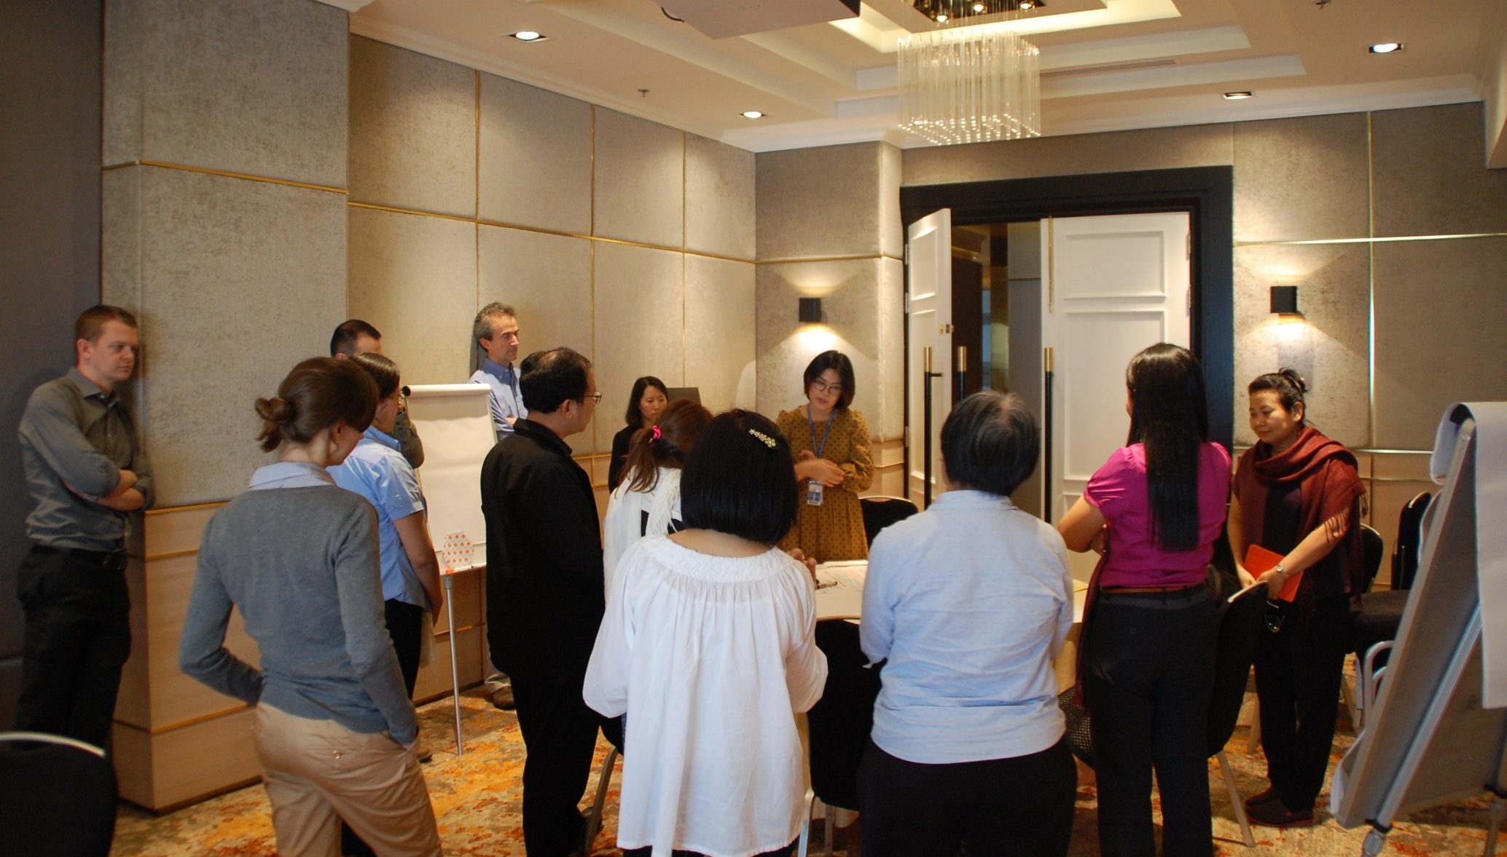
Coordination
COORDINATION
Governments of the country of origin & destination
Civil society organizations
Migrant groups
Experts & practitioners

Slide 17
Next Steps
Translations and use of materials
Operational tools
Dissemination of the Guidelines

Slide 18
Contact: MICIC Initiative Secretariat
International Organization for Migration
17, Route des Morillons, Geneva
MICICSecretariat@iom.int

Slide 20
REGIONAL TRAINING WORKSHOP
PROTECTING NATIONAL ABROAD AFFECTED BY CRISIS
Proposal of new activity to the RCM

Slide 21
Overall Objective
Enhance regional capacities to address the needs of migrants in countries experiencing a crisis, and prevent indirect, longer-term negative impacts on the well-being of communities of origin and destination, to which migrants actively contribute.

Slide 22
Specific Objectives
TO STRENGTHEN THE AWARENESS of the personnel of home country institutions tasked to support and assist citizens abroad ON THE SPECIFIC CHALLENGES their nationals face when confronted with crises in their host country
TO PROVIDE CONCRETE INFORMATION and practical guidance TO REDUCE MIGRANTS’ VULNERABILITY through a variety of measures covering both emergency preparedness and response
TO BUILD CAPACITY OF CONSULAR OFFICIALS to address some of these challenges before, during and after crises, including through the use of specific tools and the development of CONSULAR CONTINGENCY PLANS
TO PROMOTE COORDINATION among relevant institutional actors of countries of origin and of destination, at the national and regional level.

Slide 23
Preliminary Agenda (summary)
Day 1: Actors and Frameworks
Introduction
Day 2: Planning and Response
Profiling and Tracking Migrants
Communicating before and during crisis
* Day 3: Cooperation
Best Practices Repository
Dialogue : development of Cooperation Mechanisms (Regional, National, Local)
Vulnerable migrants and crisis situations
Actors and frameworks
Evacuations, assistance and recuperation
* The duration of the training is subject to confirmation of funding and availability of participants

Slide 24
Participants (proposal)
Members of the RCM Regional Network for Consular Protection
Officials from other institutions (Migration, Children or Emergency Institutions …)
Representatives of the Regional Network of Civil Society Organizations on Migration (RNCOM)
Observers of the RCM

Slide 25

Sponsorship

