Slide 1
CDC Responds to ZIKA
Zika Outbreak Overview
Martin Cetron, MD
Division of Global Migration and Quarantine
National Center for Emerging and Zoonotic Infectious Diseases
Centers for Disease Control and Prevention

Slide 2
Zika virus infection (Zika):
Current Situation,
Disease Overview, and
Key Messages
National Center for Emerging and Zoonotic Infectious Diseases
Presented on Sept 28,2016
Division of Global Migration and Quarantine

Slide 3

Where has Zika virus been found?
Before 2015, Zika outbreaks occurred in Africa, Southeast Asia, and the Pacific Islands.
Currently outbreaks are occurring in many countries and territories.
Notes:
- In December 2015, the Commonwealth of Puerto Rico, a United States territory, reported its first confirmed locally transmitted Zika virus case.
- Cases of local transmission have recently been confirmed in two other US territories, the United States Virgin Islands, and American Samoa. For the most recent case counts, visit CDC’s Cases in the United States webpage.

Slide 4
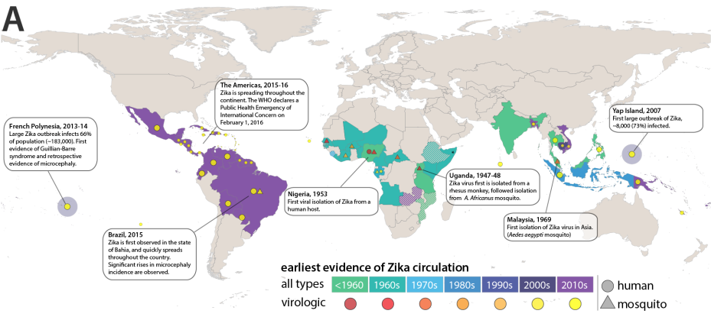

Slide 5
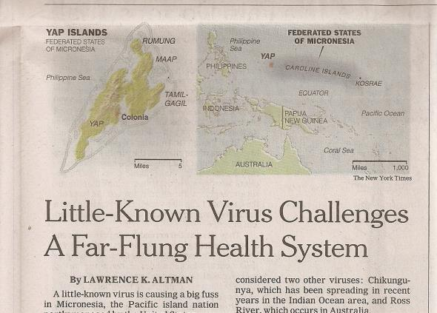
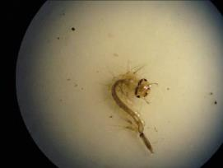
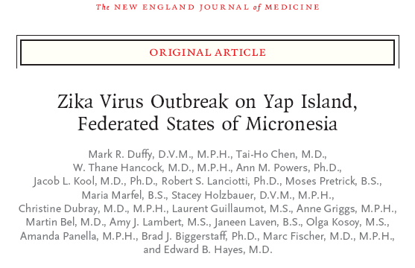
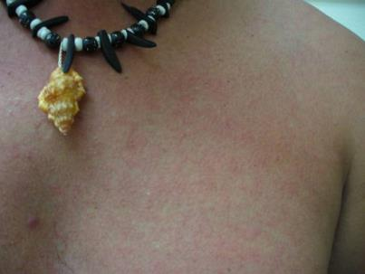
New York Times, 3 July 2007
Zika virus
FSM, 2007
N Engl J Med 2009, 360;24
Notes:
The USAPI has a distinction in being the region where the world’s first outbreak caused by Zika virus was identified and studied in Yap State of the Federated States of Micronesia in 2007.
Although Zika virus had been identified in 1947 in Africa and cases and small clusters had been identified in other parts of the world, including in SE Asia, this virus remained largely obscure and likely under-diagnosed and under-recognized until it landed in Yap State in 2007.
Characteristics of the outbreak in Yap State that resulted in identification of Zika virus:
Immunologically naïve island population that had likely not been exposed to Zika in recent history
A public health surveillance infrastructure that was well-integrated with clinical services
Well-trained and experienced (“astute”) clinicians that suspected that the illnesses were similar to but distinct from previous dengue outbreaks
Robust laboratory services supported by regional specimen shipping protocols
Linkages with CDC and WHO that facilitated rapid response to support Yap and FSM health authorities
The additional study of this outbreak raised international awareness of the potential for Zika virus to cause outbreaks, prompted other laboratories to develop tests for Zika, and provided some early clinical information about acute Zika infection, including information that many of those infected might not show symptoms.

Slide 6
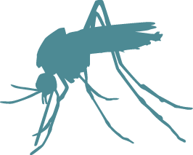
Overview of the Outbreak
May 7, 2015: PAHO issues alert for first confirmed Zika virus infections in Brazil
December 2015: The first regional travel notices for Zika in South America and Mexico were posted
January 22: CDC activated its EOC
February 1: WHO declared Public Health Emergency of International Concern

Slide 7
Zika Timeline of Events
Outbreaks in Africa, Southeast Asia, Pacific Islands
CDC posts first regional travel notices for Zika
WHO declares PHEIC
May 2015
Jan 2016
< 2015
PAHO issues alert of first confirmed Zika virus infections
Dec 2015
CDC activates EOC
Feb 2016
Notes:
Before 2015, Zika outbreaks occurred in Africa, Southeast Asia, and the Pacific Islands.
May 7, 2015: PAHO issues alert for first confirmed Zika virus infections in Brazil
December 2015: The first regional travel notices for Zika in South America and Mexico were posted
January 22: CDC activated its EOC
February 1: WHO declared Public Health Emergency of International Concern

Slide 8
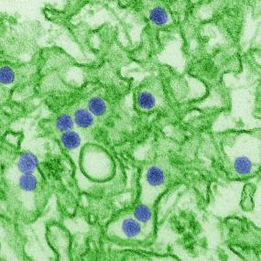
What is Zika?
A virus spread primarily through the bite of an infected Aedes mosquito
Many people won’t even know they have Zika
For those who do get sick,
Zika is usually a mild illness
There is no specific medicine or vaccine for Zika
Zika infection in a pregnant woman causes severe birth defects
Presented on 07/08/2016
Notes:
Image: This is a digitally-colorized transmission electron micrograph (TEM) of Zika virus, which is a member of the family Flaviviridae.

Slide 9
Zika Virus
Flavivirus – same family as dengue, yellow fever, West Nile
Transmission
  Spread primarily by mosquitoes
  Sexual transmission
  Probable blood transfusion transmission
First identified in 1947 in Uganda
Outbreak in 2007 in Yap, Federated States of Micronesia
Subsequent outbreaks
  South Pacific (French Polynesia and New Caledonia 2013–14)
  Americas 2015
Association with birth defects noted in Brazil in 2015

Slide 10
Zika Transmission:
How Do You Get Zika?
Presented on Sept 28, 2016

Slide 11
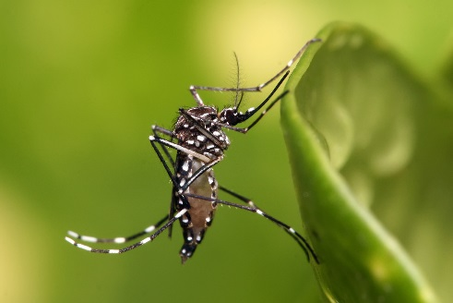
Aedes Aegypti Mosquito
By Muhammad Mahdi Karim

Slide 12
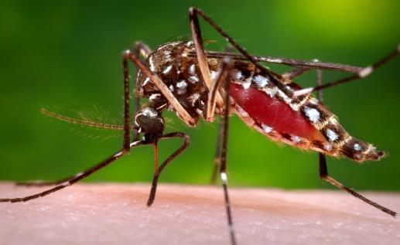
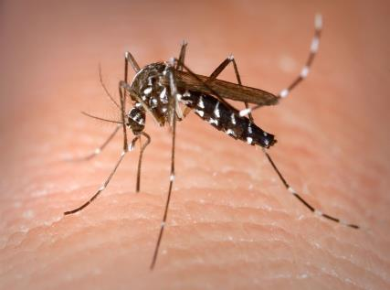
Vectors of Zika Virus
Aedes Agypti
Aedes Albopictus
Notes:
Why its difficult to control aedes
- close association with humans
Can breed in toilets, septic tanks, tree cavities and closets
Eggs can withstand drying
Can survive without water
Is undergoing continuous adaptation and change

Slide 13
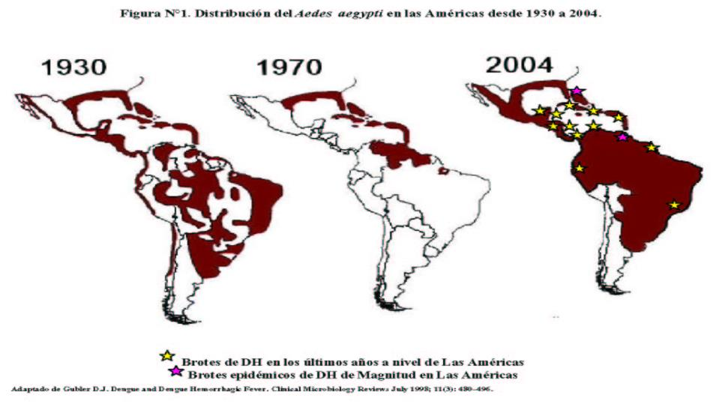
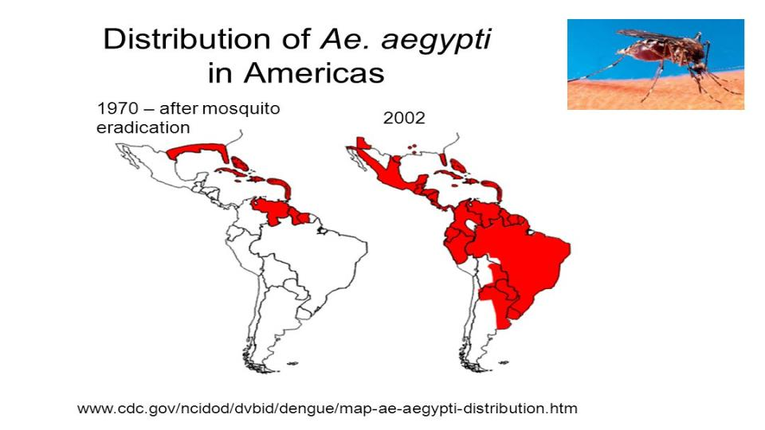
Source: JAMA Pediatrics

Slide 14
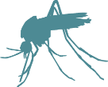
Zika Transmission: Fact vs Myth
Zika spreads through
  Mosquito bites
  Sex with an infected person
  From a pregnant woman to her fetus
  Possibly blood transfusion
Zika cannot spread through
  Casual contact
  Air (e.g. coughing and sneezing)
Presented on 07/08/2016

Slide 15
Aedes Mosquitoes
Aggressive daytime biters, but they also bite at night
Live both indoors and outdoors, near people
Same mosquitoes that spread dengue, chikungunya, and yellow fever
Presented on 07/08/2016

Slide 16
Zika Transmission from Aedes Mosquitoes
If a mosquito bites an infected person while the virus is still in that person’s blood, it can get the virus and then spread it by biting another person
  It takes several days for a newly infected mosquito to be able to transmit Zika to another person
Presented on 07/08/2016

Slide 17
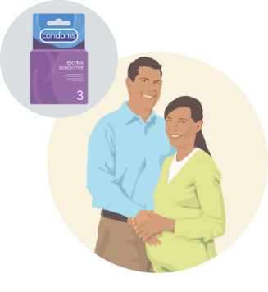
Sexual Transmission
Zika can be passed to sex partners during vaginal, anal, or oral sex
Zika can be passed to sex partners before, during, or after symptoms start
Zika can be passed to sex partners in the absence of symptoms
If you have a sex partner who lives in or travels to an area with Zika, you should use condoms or other barriers that protect against infection from start to finish every time you have sex, or do not have sex during the pregnancy
Presented on 07/08/2016

Slide 18
Sexual Transmission
Zika virus can stay in semen longer than in blood, but we don’t know exactly how long Zika stays in semen or how long it can be passed to sex partners.
Condoms can reduce the chance of getting Zika from sex if used correctly from start to finish, every time you have vaginal, anal, or oral sex.
Not having sex can eliminate your risk of getting Zika from sex.
Presented on 07/08/2016

Slide 19
Outcomes:
What Happens If You Get Zika?
Presented on 07/08/2016

Slide 20

How does Zika virus affect people?
Anyone who lives in or travels to an area with Zika and has not already been infected with Zika virus can get it.
Many people with Zika will not have symptoms or will only have mild symptoms.
Symptoms last several days to a week.
Severe disease requiring hospitalization is uncommon.

Slide 21
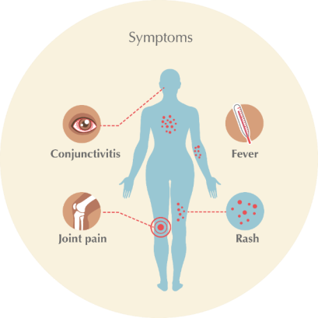
Symptoms
Many people with Zika virus do not get sick
Most common symptoms
  Fever
  Rash
  Joint pain
  Conjunctivitis (red eyes)
Other common symptoms include
  Muscle pain
  Headache
Presented on 07/08/2016

Slide 22
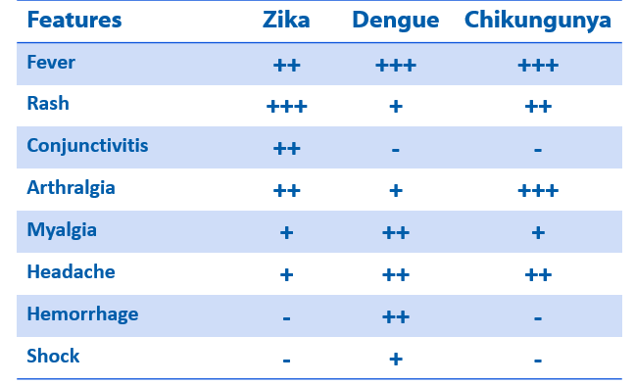
Clinical features: Zika virus compared to dengue and chikungunya
Rabe, Ingrid MBChB, MMed “Zika Virus- What Clinicians Need to Know?” (presentation, Clinician Outreach and Communication Activity (COCA) Call, Atlanta, GA, January 26 2016)
http://www.cdc.gov/zika/comm-resources/clinicianppt.pptx

Slide 23

Zika and Pregnancy
A pregnant woman can pass Zika to her fetus
Zika infection in pregnancy can cause birth defects
  Some women with Zika deliver apparently healthy babies
No evidence to suggest that pregnant women are more susceptible or experience more severe disease during pregnancy
No evidence to suggest that past Zika virus infection poses an increased risk of birth defects for future pregnancies
Presented on 07/08/2016

Slide 24
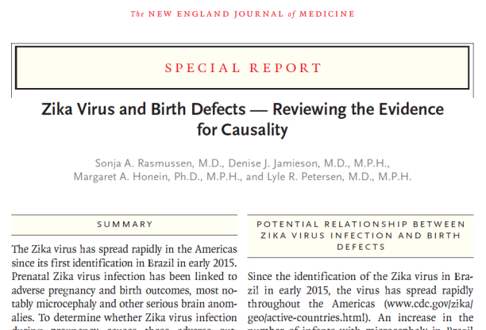
Zika is a Cause of Microcephaly
Notes:
On April 13th, building on the hard work of many scientists, CDC concluded that Zika virus is a cause of microcephaly and other brain anomalies.
To reach this conclusion, CDC conducted a systematic evaluation of the evidence, which showed that a causal relationship exists between prenatal Zika virus infection and microcephaly and other serious brain anomalies.

Slide 25
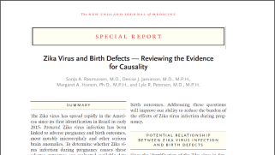
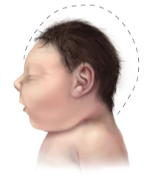
Zika Virus Infection and Birth Defects
Causal relationship exists
  Microcephaly
  Other serious brain anomalies
Confirmed congenital syndrome
  2,066 in the Americas
  1,949 of those in Brazil
Source: NEJM and PAHO, 9/22/16
Notes:
NEJM - A causal relationship exists between prenatal Zika virus infection and microcephaly and other serious brain anomalies
PAHO – As of September 22, 2106, there have been 2,066 reports of confirmed congenital syndrome associated with Zika virus infection in the Americas. Of those, 1,949 occurred in Brazil
http://www.paho.org/hq/index.php?option=com_docman&task=doc_view&Itemid=270&gid=36250&lang=en

Slide 26

How does Zika affect fetuses and infants?
Other problems have been detected in fetuses and infants infected with Zika virus before birth.
  Miscarriage, stillbirth, absent or poorly developed brain structures, eye defects, hearing deficits, and impaired growth
No reports of infants getting Zika through breastfeeding.

Slide 27
Adverse Outcomes and Zika Virus
Linked to miscarriage and stillbirth
  Evidence insufficient to confirm Zika virus as cause
A range of problems related to brain injury have been detected
  Eye abnormalities
  Hearing impairment
  Seizures
  Swallowing impairment
  Limb abnormalities
  Severe irritability
  Developmental delay
  Growth abnormalities
Karwowski MP, Nelson JM, Staples JE, et al. Zika Virus Disease: A CDC Update for Pediatric Health Care Providers. Pediatrics. 2016;137(5):e20160621
Notes:
In addition to microcephaly, other problems have been detected in pregnancies and among fetuses and infants infected with Zika virus before birth, such as miscarriage, stillbirth, absent or poorly developed brain structures, defects of the eye, hearing deficits, and impaired growth.
While the evidence supports a causal link with microcephaly and other severe fetal brain defects, many questions still remain.

Slide 28
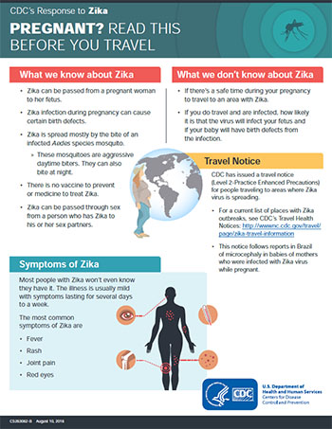
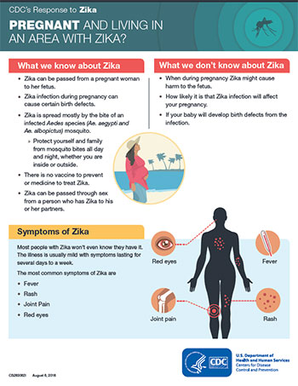
CDC Information Flyers for Pregnant Women
http://www.cdc.gov/zika/pdfs/zika-pregnancytravel.pdf

Slide 29
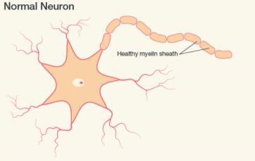
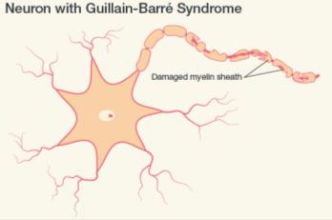
Does Zika cause Guillain-Barré syndrome (GBS)?
GBS is strongly associated with Zika; however, only a small proportion of people with recent Zika virus infection get GBS
GBS)is a rare disorder that can cause muscle weakness and paralysis for a few weeks to several months. Most people fully recover from GBS, but some have permanent damage.

Slide 30
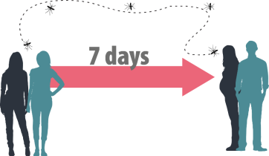
What to do after getting Zika
Protect yourself from mosquito bites. During the first week of illness, Zika virus can be found in blood.
The virus can be passed from an infected person to a mosquito through bites.
An infected mosquito can spread the virus to other people.
Zika virus can stay in blood for about a week, and mosquitoes can bite you and then infect others through bites.

Slide 31
Current Situation
Brazil, along with many destinations in the Americas, is experiencing an outbreak of Zika virus.
CDC has issued travel notices for destinations where Zika virus is spreading locally
  Local transmission means that mosquitoes have been infected with Zika virus and are spreading it to people
  Places with imported cases (cases in travelers returning from affected areas) or places where there has been Zika transmission in the past are not included in the travel notices
Because Zika virus infection in pregnant women can cause serious birth defects, CDC has special travel recommendations for pregnant women
Presented on 07/08/2016

Slide 32
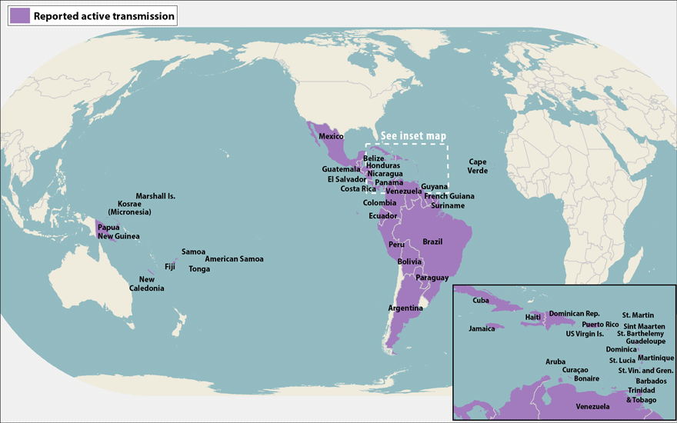
Where Are Zika Outbreaks Occurring?
Currently: Outbreaks occurring in many countries and territories
Before 2015: Outbreaks in Africa, Southeast Asia, and the Pacific Islands
Presented on 07/08/2016

Slide 33
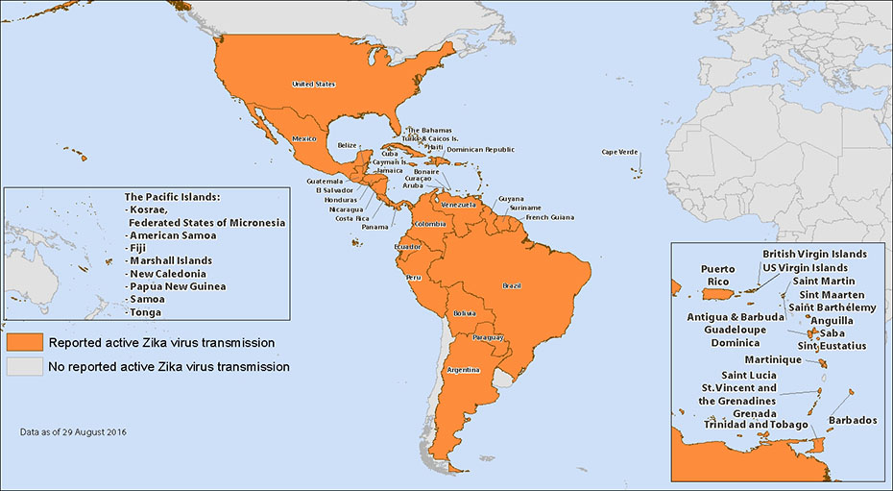

Slide 34
U.S. Travel Volumes and Zika
Border Crossings per Year – 2015
Air | 101 million
Sea | 21 million
Land | 234 million
Total | 359 million
> 300 official US ports of entry (POE)
Travelers from countries with Zika
  ~60% of total
  Can arrive at any U.S. airport, including on domestic flights
Travel from Countries with Zika
Air | 34 million
Sea | 9 million
Land | 173 million
Total | 216 million
Source: Diio; Department of Transportation, Bureau of Transportation Statistics; U.S. Customs and Border Protection

Slide 35
Top 10 First U.S. Ports of Entry
Diio: November, 2014 – October, 2015

Slide 36
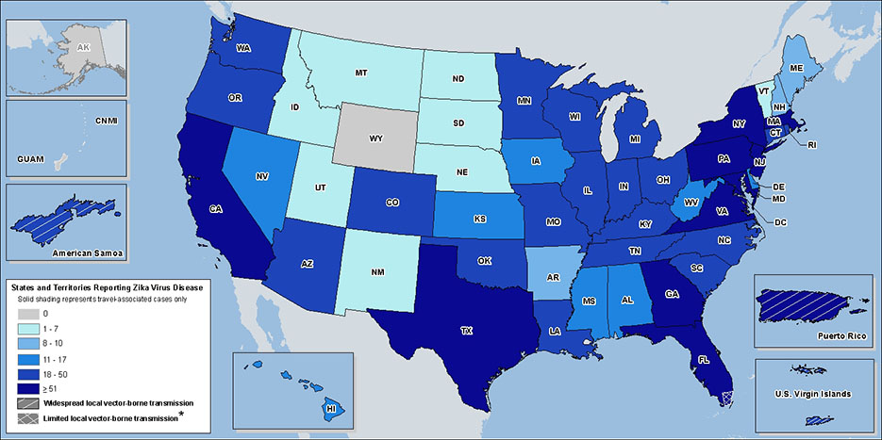
Zika *Cases Reported to ArboNet as of Sept 21,2016:
CONUS 3,358 ; US Territories 19,777
US Zika Cases in Pregnant Women Reported Sept 15,2016:
CONUS 749 ; US Territories 1,348

Slide 37
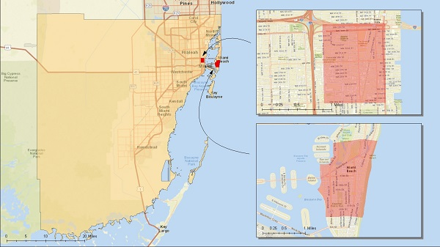

Slide 38
Cases in the Americas
Autochthonous
  500,557 suspected
  120,785 confirmed
Incidence Rate
  62.26 per 100,000 population
Source: PAHO, 9/22/16
Notes:
As of September 22, 2016
http://www.paho.org/hq/index.php?option=com_docman&task=doc_view&Itemid=270&gid=36250&lang=en

Slide 39
Confirmed Autochthonous Cases for Select Countries/Territories in the Americas
Country/Territory Confirmed Cases
Brazil 78,421
Puerto Rico 19,967
Colombia 8,826
Mexico 3,015
Nicaragua 1,900
Costa Rica 1,076
Venezuela 1,631
Source: PAHO, 9/22/16
Notes:
As of September 22, 2016
http://www.paho.org/hq/index.php?option=com_docman&task=doc_view&Itemid=270&gid=36250&lang=en

Slide 40
Trends
Cases are going up in …
Costa Rica
Guatemala
Nicaragua
Panama
Saint Martin
Source: PAHO, 9/22/16
Notes:
As of September 22, 2016
http://www.paho.org/hq/index.php?option=com_content&id=11599&Itemid=41691

Slide 41

Trends
Cases are going down in …
Puerto Rico
Many other Caribbean countries
South America
Source: PAHO, 9/22/16
Notes:
As of September 22, 2016
http://www.paho.org/hq/index.php?option=com_content&id=11599&Itemid=41691

Slide 42
Prevention:
How Do I Avoid Getting Zika? How Do I Avoid Spreading it to Others?
Presented on 07/08/2016

Slide 43
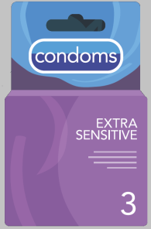
What You Can Do
Protect yourself
  Prevent mosquito bites
  Avoid sexual transmission of Zika
If you are pregnant, don’t travel to areas with Zika
Talk to your health care provider
Prevent spread after travel
Presented on 07/08/2016

Slide 44
Zika is primarily spread through mosquito bites. Protect yourself and others.
Preventing Mosquito Bites

Slide 45
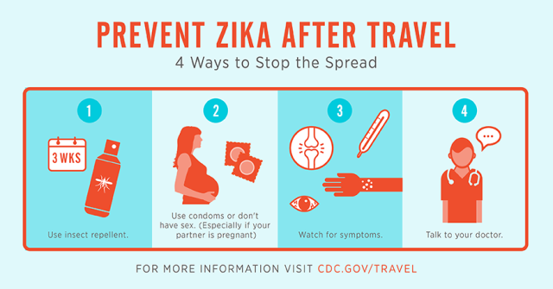
After Travel
People returning from the Olympics might be infected with Zika, even if they do not feel sick
Protect others by taking steps to avoid mosquito bites for 3 weeks after travel
  These steps will prevent you from passing Zika to mosquitoes that could spread the virus to other people
Presented on 07/08/2016

Slide 46
Wait Time to Attempt Conception
 | With diagnosis of Zika virus disease | Asymptomatic with possible exposure* (travel or sex)
Women | 8 weeks after symptom onset | at least 8 weeks after exposure
Men | At least 6 months after symptom onset
*Possible exposure to Zika virus includes travel to or residence in an area where active Zika virus is spreading or unprotected sex (without a condom) within the past 6 months with a person who has traveled to or has lived in an area where Zika virus is spreading.
Presented on 07/08/2016

Slide 47
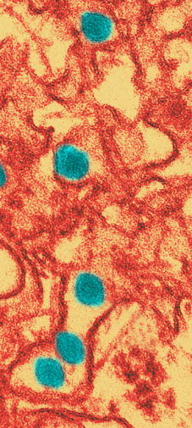
Diagnostic Testing for Zika Virus
During first two weeks after the start of illness, Zika virus infection can often be diagnosed by performing real-time reverse transcriptase polymerase chain reaction (rRT-PCR) on serum and urine.
Serology for IgM and neutralizing antibodies in serum collected up to 12 weeks after illness onset.
Plaque reduction neutralization test (PRNT) for presence of virus-specific neutralizing antibodies in paired serum samples.
Immunohistochemical (IHC) staining for viral antigens or RT-PCR on fixed tissues.
Notes:
During first two weeks after the start of illness, Zika virus infection can often be diagnosed by performing real-time reverse transcriptase polymerase chain reaction (rRT-PCR) on serum and urine.
Serology for IgM and neutralizing antibodies in serum collected up to 12 weeks after illness onset.
Plaque reduction neutralization test (PRNT) for presence of virus-specific neutralizing antibodies in paired serum samples.
Immunohistochemical (IHC) staining for viral antigens or RT-PCR on fixed tissues.

Slide 48

What is CDC doing?
Activated Emergency Operations Center (EOC) to level 1
Providing on-the-ground support in areas with Zika
Educating healthcare providers and the public about Zika
Posting travel guidance
Providing laboratories with diagnostic tests
Conducting studies to learn more about Zika and its effects
Notes:
CDC is working through our country offices, our programs, and with international partners to
o Alert healthcare providers and the public about Zika.
o Provide health laboratories with diagnostic tests. CDC is assisting countries with Zika testing by supplying them with reagents for molecular diagnostic lab testing.
o Monitor and report cases of Zika, which will help improve our understanding of how and where Zika is spreading.
o Learn more about Zika and its effects on pregnancy and infants as well as potential link between Zika and Guillain-Barré syndrome.
o Conducting a study to evaluate the persistence of Zika virus in semen, vaginal fluids and urine.
Laboratory assistance
Through the CDC’s Emergency Operations Center, CDC is assisting countries with Zika testing by supplying them with reagents for molecular diagnostic lab testing.
CDC staff are providing essential lab assistance, including organizing and triaging requests for Zika virus PCR reagents, needed for Zika diagnostics testing, from CDC’s 10 Global Disease Detection Regional Centers and around the world.
CDC is working in laboratories and in dozens of countries, with ministries of health, and with partners around the world to develop a deeper understanding of Zika virus. We are also helping to prevent, control, and respond to the Zika outbreak, along with outbreaks of other diseases like chikungunya, dengue fever, malaria, yellow fever, and other vector-borne diseases.
CDC also stood up and operates regional Zika virus laboratory diagnostic capabilities at two of the most critical Global Disease Detection Regional Centers - the Central America Regional Center in Guatemala and the SE Asia Regional Center in Thailand.

Slide 49
What is CDC doing?
Working with partners to:
  Monitor and report cases
  Conduct studies to learn more about the potential link between Zika and Guillain-Barré syndrome
  Create action plans for state and local health officials to improve Zika preparedness
  Publish and disseminate guidelines to inform testing and treatment of people with suspected or confirmed Zika
  Publish and disseminate conclusions on the causal association between Zika and microcephaly

Slide 50

Travel Health Notices
Travel Notice Level | Recommended Preventive Measures | Outbreak Examples
Level 1, Watch | Follow usual precautions | Measles in the Philippines, 2014
Level 2, Alert | Use enhanced precautions | Zika, 2016
Level 3, Warning | Avoid nonessential travel | Ebola in West Africa, 2014

Slide 51
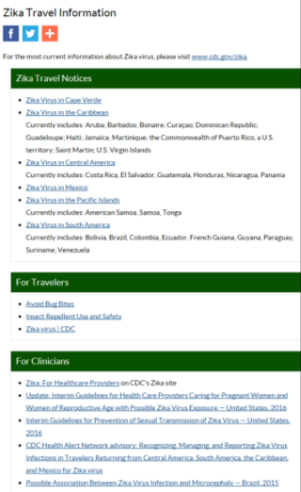
CDC Travel notices
58 Overall
48 in the Americas
  29 in the Caribbean
  11 in South America
  7 in Central America
  1 in North America
8 in the Pacific Islands
1 in Africa
1 in Asia

Slide 52
CDC Travel recommendations
If you are pregnant, do not travel to areas with Zika.
  If you must travel, talk to your doctor or other healthcare provider before your trip.
If you are trying to get pregnant, talk to your doctor or other healthcare provider before you travel.

Slide 53
CDC Travel recommendations
If you choose to travel:
  Strictly follow steps to prevent mosquito bites to protect yourself and your family.
  Even if you do not feel sick, travelers from an area with Zika should take steps to prevent mosquito bites for 3 weeks so they do not spread Zika to uninfected mosquitoes.
  Use condoms or do not have sex while traveling to areas with Zika.

Slide 54
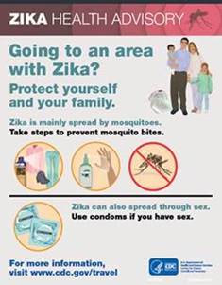
Activities at US Ports of Entry
Reinforcing health messages to travelers
Interacting with partners
Supporting local preparedness and response in high-risk or affected US jurisdictions
  US-Mexico border region
  US territories and protectorates

Slide 55
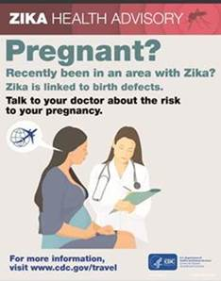
Activities at US Ports of Entry
CDC is not preventing people with Zika infection from traveling.
CDC is not conducting enhanced entry screening for travelers coming from areas with Zika.
CDC does not require or recommend spraying (disinsection) of airplanes or ships arriving from areas with Zika.
Notes:
http://www.cdc.gov/quarantine/air/managing-sick-travelers/commercial-aircraft/zika-qa.html

Slide 56
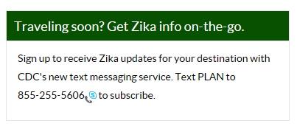
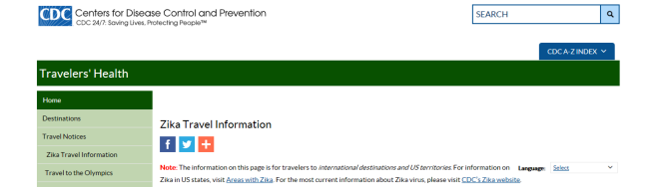
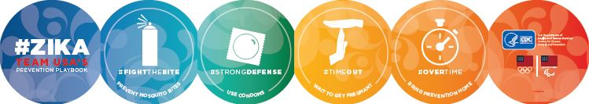
Zika Travel Information
Notes:
Zika Travel Information Website
Zika text messaging updates by destination
Olympics brochure

Slide 57
What’s Next?
?
Difficult to predict
May see increase in number of
  Pregnant women infected
  Microcephaly in infants
Source: JAMA Pediatrics
Notes:
Difficult to predict what will happen next
But, as an example, a recent analysis from CDC estimates that 5,900-10,300 pregnant women might be infected during the Zika virus outbreak in Puerto Rico in 2016
CDC scientists estimated that 100-270 of these infections in pregnant women might lead to microcephaly in infants between mid-2016 and mid-2017

Slide 58
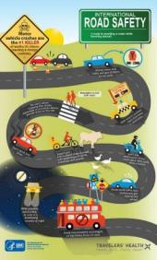
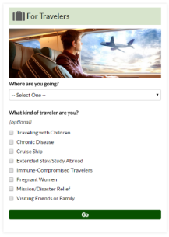





CDC Resources
Web and Social Media
Communication Materials
Mobile Apps
Presented on 07/08/2016

Slide 59

Travelers’ Health Website
www.cdc.gov/travel
Presented on 07/08/2016

Slide 60
For more information, contact CDC
1-800-CDC-INFO (232-4636)
TTY: 1-888-232-6348 www.cdc.gov
The findings and conclusions in this report are those of the authors and do not necessarily represent the official position of the Centers for Disease Control and Prevention.

