Slide 1
Consular Diplomacy in Mexico
Protocol of Consular Assistance for Unaccompanied Migrant Boys, Girls and adolescents
General Directorate for Protection of Mexicans Abroad
1

Slide 2
A Fundamental Change: Consular Diplomacy
Migrants as subjects of rights and partners for development. Evolving from assistance and protection with a paternalistic approach to a strategy of empowerment of migrants.
Assistance for transnational families. Actions to assist migrants are not only implemented abroad; schemes are sought to provide comprehensive assistance at a national and international level.
A focus on people and not on administrative processes. A human rights approach. Protocols for consular assistance. A system for recording and following up on each case.
A regional and multilateral approach. Regional Conference on Migration, Global Consular Forum, bilateral consular dialogue.

Slide 3
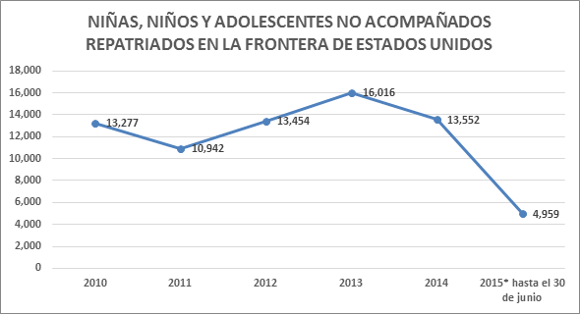
Background
Border consulates (12) are involved in approximately 14,000 initiatives for the repatriation of unaccompanied migrant boys, girls and adolescents each year.
The objective of developing a Protocol for Consular Assistance is to provide consular staff with the necessary tools to improve protection and assistance for migrant boys, girls and adolescents.
Prepared with data from the General Directorate for Protection of Mexicans Abroad.

Slide 4
Basis of the Protocol
Convention on the Rights of the Child;
Other International Human Rights Treaties;
General Comments 6 & 14 of the Committee on the Rights of the Child;
Advisory Opinion 21/14 of the Inter-American Committee on Human Rights – CIDH;
Advisory Opinion 16/99 of CIDH;
General law on the rights of boys, girls and adolescents.
To guarantee the rights of boys, girls and adolescents in the context of migration.

Slide 5
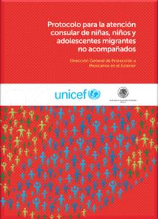
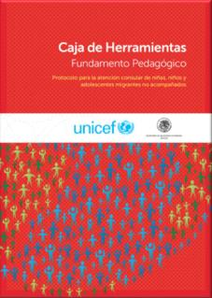
What is it and what is it for?
It is a tool to strengthen mechanisms implemented by consular staff, aimed at guaranteeing the right to protection and assistance of unaccompanied migrant boys, girls and adolescents.
The Protocol provides guidelines for consular staff on what to do, how and why.
Seeks to avoid revictimization.
Enables an initial assessment in order to identify particular vulnerabilities and special protection needs.
Initiates the implementation of a chain of protection actions. The purpose is to ensure appropriate referral of cases, with a focus on the best interest of the boy, girl or adolescent.

Slide 6
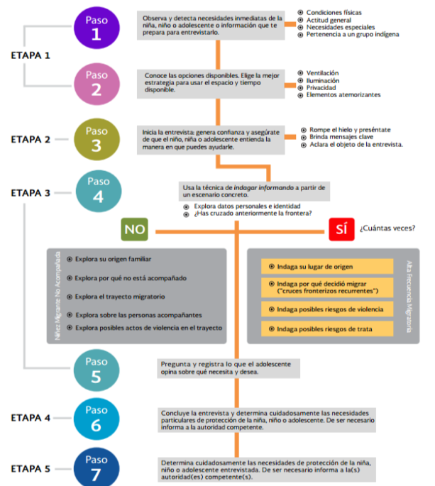
Step
Observe and identify the immediate needs of the boy, girl or adolescent or gather information that helps you prepare for the interview.
Physical conditions;
General attitude;
Special needs;
Belonging to an indigenous group.
PHASE 1
Step
Inform yourself about the available options. Select the most appropriate strategy for using the available time and space.
Ventilation;
Lighting;
Privacy;
Intimidating elements.
PHASE 2
Step
Begin the interview, build trust and ensure that the boy, girl or adolescent understands how you can help him or her.
Break the ice and introduce yourself;
Convey key messages;
Clarify the purpose of the interview.
Step
PHASE 3
Use the technique of finding out by informing based on a specific scenario.
Ask about personal data and identity;
Have you crossed the border before?
How many times?
How is it used?
YES
Ask about family origin;
Ask why he or she is unaccompanied;
Ask about the migration route;
Ask about persons accompanying the boy, girl or adolescent;
Ask about potential acts of violence along the migration route.
Ask about the place of origin;
Ask why he or she decided to migrate (“recurrent border crossings”);
Ask about potential risk of violence;
Ask about potential risk of trafficking in persons.
Unaccomp. migrant boy, girl or adolescent
Frequent migration
Step
Ask and write down the opinion of the adolescents about his or her needs and wishes.
Step
End the interview and carefully determine the particular protection needs of the boy, girl or adolescents. Inform competent authorities if necessary.
PHASE 4
Step
PHASE 5
Carefully determine the protection needs of the interviewed boy, girl or adolescents. Inform competent authorities if necessary.

Slide 7
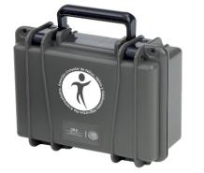
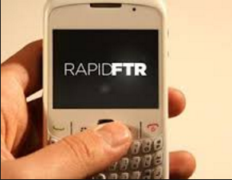
Materials and RapidFTR
A TOOL BOX with index cards. For example: “How do adolescents think?”; “How should the space be used?”; tools to identify violence, trafficking in persons, exploitation, etc.
Cooperation with UNICEF concerning use of the RapidFTR app: to collect essential data to be able to locate relatives and identify potential vulnerable situations.
Prototype of the Tool Box that will be provided to consular staff.

Slide 8
Implementation and Evaluation
Pilot Programme→ At 3 consulates. 80% of the staff obtained more information than they would have obtained without the implementation of the Protocol. 100% expressed that they were able to identify special needs of protection and restoration of rights.
Six regional training workshops were conducted (July 2015) on use of the Protocol, with participation of officials in charge of protection from 28 consular representations.
Implementation of consular diplomacy initiatives, making use of institutional protection networks in Mexico and abroad.
Evaluation of results in collaboration with UNICEF.

Slide 9
Where are we going?
Inter-institutional cooperation strategy→ To exchange strategic information (RapidFTR) with other government institutions that follow up on cases: National Institute of Migration (INM) and Integrated System for the Comprehensive Development of the Family (DIF);
To design a strategy for ongoing training and evaluation;
To consolidate a model for comprehensive assistance; not only during the protection phase, but to guarantee full respect for the rights of boys, girls and adolescents throughout every phase of the migration process.
To see the Protocol visit: http://proteccionconsular.sre.gob.mx/index.php/documentos/protocolonna

Slide 10
Any questions?
Thank you!

