Slide 1
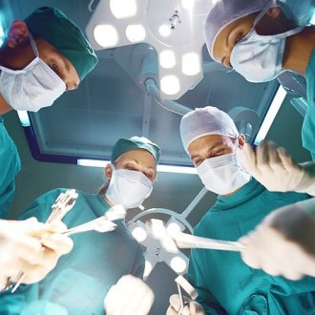
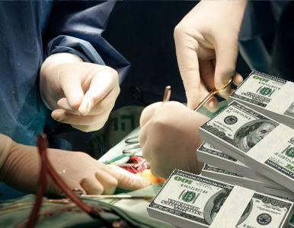
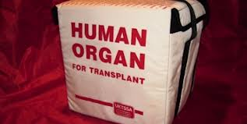
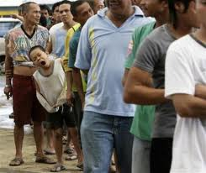
Meeting of the Liaison Officer Network to Combat Migrant Smuggling and Trafficking
Sofía Salas
IOM Costa Rica Managua, JUNE 24, 2014
Notes:
1

Slide 2
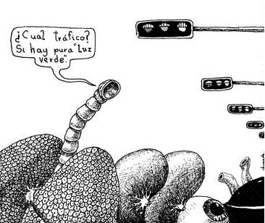
Presentation on ADVANCES,
Regional Report
“Assessing Vulnerability to Crimes relating to the Donation and Transplant of Organs, Tissues and Fluids in Central America”

Slide 3
Background
April 24, 2013: Meeting on trafficking in persons for the purpose of trafficking organs, tissues and cells, held in San José;
Participants: Ministry of Health, Medical Associations, the Judiciary, representatives from the Coalition Against Trafficking in Persons, academia, civil society, relevant experts (Spain, Latin America), IOM, etc.;
As a follow-up action and in response to a request by the Government of Costa Rica to gain a better understanding of the magnitude of the issue in the region.
A REGIONAL STUDY

Slide 4
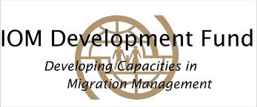
An 8-month project (Dec. 1, 2013 – July 31, 2014)
Financing:
A research protocol;
Visits to each country to collect information;
Presentation and validation of findings from the report (San José, July 2014);
Publication.

Slide 5
Primary Objective of the Study
To provide an overview of the existing vulnerabilities and risks in Central American countries relating to the proliferation of trafficking in human organs, particularly with living donors, and other related crimes such as trafficking in persons.
Central American Region
Guatemala
Honduras
El Salvador
Nicaragua
Costa Rica
Panama
Organ donation and transplant
Vulnerabilities at a national level
Organ trafficking and smuggling

Slide 6
Specific Objectives
To analyse existing procedures in each country in regard to donation, extraction and transplant of human organs.
To reflect on the prohibitions of unethical practices relating to transplants and related punishment.
To review institutional/legal systems for organ donation and transplants, with a special focus on existing gaps and vulnerabilities in the above-mentioned systems and how this can impact the proliferation of cases of trafficking in persons.
To analyse the conditions that cause populations in vulnerable situations to become victims of this crime.

Slide 7
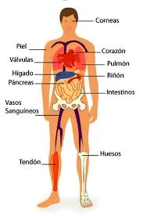
Organ Transplantation
¿WHAT IS ORGAN TRANSPLANTATION?
Complex medical procedure that consists in the moving of on organ from one body to another. The transplanted organ replaces and assumes the function of the receipient´s damaged organ
l
• Kidney
• Liver
• Heart
• Lung
• Pancreas
• Intestine
¿WHICH ORGANS AND TISSUES MAY BE TRANSPLANTED?

Slide 8
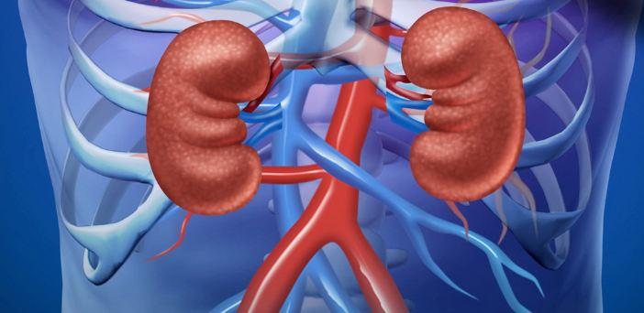
Clarification
This study has focused on KIDNEYS since only kidney transplants are performed in the majority of countries.
The cases of organ trafficking that may be related to situations of trafficking in persons and that have been investigated in the region and around the world are for kidneys:
More commercialized;
An increase in the number of persons with chronic renal failure;
Surgery is less complicated.
f

Slide 9
Findings
Significant differences in transplant practices between countries of the Northern Triangle and Nicaragua, Costa Rica and Panama.
Only kidney transplants are performed in the majority of countries, except for Costa Rica, where other transplants are performed as well.
Guatemala, Costa Rica and Panama: living and deceased donors. El Salvador, Honduras y Nicaragua: only living donors.
Absence of cases reported or under investigation or prosecution, relating to illicit extraction of organs in trafficking in persons (except for Costa Rica).
Absence of statistical data (or discrepancies between different sources) about transplants and, frequently, about situations of trafficking in persons.

Slide 10
Vulnerabilities
Weaknesses in public health systems in regard to donation and transplant.
Insufficient investment and promotion of the practice of transplants. Preference is given to replacement therapies such as haemodialysis.
A low number of transplants performed due to absence of the necessary installed capacity.
Violations of bioethical standards established in international instruments; i.e. immunosuppressive medication.

Slide 11
Vulnerabilities
Lack of regulations for crucial aspects in transplant laws and confusion of concepts.
This lack of regulation could lead to the existence of “blind spots” that open the door to crime.
Emotionally involved living donors.
Living donors that are not involved.

Slide 12
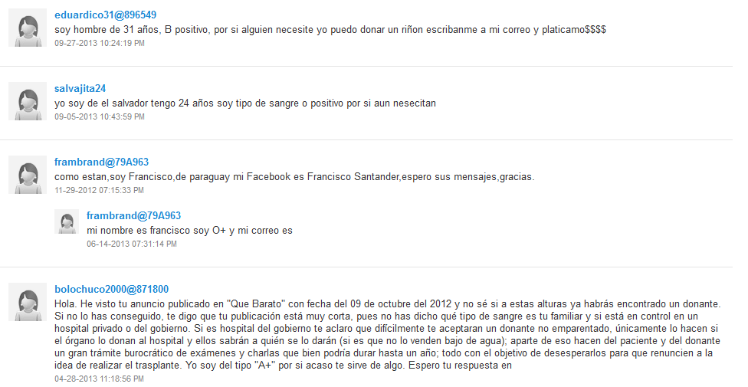

Slide 13
Vulnerabilities
Civil servants, members of NGOs and international organizations are unaware of essential aspects related to transplant techniques and their link to organ trafficking and trafficking in persons. Myths.
Lack of a real dimension of what trafficking in persons means for medical staff involved in performing transplants in each country.

Slide 14
Challenges
Reformulating/assessing legislation on transplants and trafficking in persons and viewing this as an interdisciplinary topic;
Promoting the collection and recording of statistical data;
Training different public sector institutions in charge of identifying, investigating and prosecuting trafficking in persons on all extreme cases relating to transplants;
Promoting the establishment of a national and regional transplant organization to ensure equality, diligence and transparency for each transplant;

Slide 15
Challenges
Awareness raising amongst staff of private medical centers and vulnerable population
Adequate articulation between Ministries of Health and National Counter-Trafficking Coalitions – budget allocation
The need for FOLLOW-UP (i.e. more investigation) to further address the issue.

Slide 16
THANK YOU

