Slide 1

Organización Internacional para las Migraciones
Taller regional en materia de protección temporal y/o visa humanitaria en situaciones de desastres
San José, Costa Rica
Febrero10-11, 2015
Luz TANTARUNA
Salvador GUTIÉRREZ

Slide 2
Objetivos de la presentación
Objetivos de la presentación:
  Exponer brevemente la experiencia de la OIM en el tema de movilidad fronteriza en el contexto de desastres como insumo útil para el desarrollo de reflexión y políticas en la materia.

Slide 3
Índice de la presentación
1- Bases para el involucramiento de la OIM en la temática
2- Iniciativas de OIM en la temática
3- El MCOF como marco útil para la reflexión, elaboración y desarrollo de políticas en materia de gestión de emergencias migratorias

Slide 4
1. Bases para el involucramiento de la OIM en la temática

Slide 5
Bases jurídicas
Instrumentos internacionales base en materia ambiental:
  Convención Marco de las Naciones Unidas sobre el Cambio Climático (CMNUCC)
  Normativa Internacional de Respuesta a Desastres
Instrumentos internacionales base en derechos humanos:
  Pacto internacional de derechos civiles y políticos (1966)
  Pacto internacional de derechos económicos, sociales y culturales (1966)
  Convención internacional sobre la eliminación de todas las formas de discriminación racial (1965)
  Convención contra la tortura y otros tratos o penas crueles, inhumanas o degradantes (1984)
  Convención de los derechos del niño (1989)
  Convención internacional sobre la protección de los derechos de todos los trabajadores migratorios y de sus familiares (1990)
  Principios rectores de los desplazamientos internos
  Leyes de nacionalidad
Notes:
Environmental law
UN Framework Convention on Climate Change
UNFCCC was initially unrelated to migration
Conference of the Parties has integrated climate change from the Cancun Agreements (2010)
The Parties should adopt “Measures to enhance understanding, coordination and cooperation with regard to climate change induced displacement, migration and planned relocation, where appropriate, at the national, regional and international levels”
Doha Decisions (2012): advance understanding of loss and damages deriving from climate change, including impact on human mobility, displacement and migration.
International Disaster Response Law
International Law Commission Draft Articles on the Protection of Persons in the event of disaster
1st World Disaster Reduction Conference (2005) and Hyogo Framework for Action
It is more at the border between environmental law and humanitarian law. Usually applicable to both man-made and natural disasters.
Human rights law
International Covenant on Civil and Political Rights (1966)
International Covenant on Economic, Social and Cultural Rights (1966)
International Convention on the Elimination of All Forms of Racial Discrimination (1965)
Convention against Torture and Other Cruel, Inhuman or Degrading Treatment (1984)
Convention on the Rights of the Child (1989)
International Convention on the Protection of the Rights of All Migrant Workers and Members of Their Families (1990)
Guiding Principles on Internal Displacement
Nationality Law
There are also regional legal approaches:
Additional Protocol to the American Convention on Human Rights in the Area of Economic, Social and Cultural Rights (Protocol of San Salvador)
Article 11: right to healthy environment
Case of the Sawhoyamaxa Indigenous Community v. Paraguay (IACtHR, 2006) and Case of the Yakya Axa Indigenous Community v. Paraguay (IACtHR, 2005)
MERCOSUR Declaration of Principles on International Refugee Protection
Cartagena Declaration on Refugees (developing)

Slide 6
Bases conceptuales
1. Migrantes ambientales
Los migrantes por motivos ambientales son personas o grupos de personas que, por razones de cambios repentinos o progresivos del medio ambiente que afectan adversamente su vida o sus condiciones de vida, se ven obligados a abandonar sus lugares de residencia habituales o deciden hacerlo ya sea con carácter temporal o permanente, y que se trasladan a otro lugar de su propio país o al extranjero”. – Definición de trabajo de la OIM
Notes:
IOM working definition of environmental migrants
Environmental migrants are persons or groups of persons who, predominantly for reasons of sudden or progressive changes in the environment that adversely affect their lives or living conditions, are obliged to leave their habitual homes, or choose to do so, either temporarily or permanently, and who move within their country or abroad.

Slide 7
Bases conceptuales
CATEGORÍAS DE MIGRACIÓN AMBIENTAL
Factores ciertos
Factores de difícil determinación
Movilidad interna de personas
Movilidad internacional de personas
Voluntariedad del movimiento
Inexorabilidad del movimiento
Movimiento temporal
Movimiento permanente
Surgimiento repentino
Cambios progresivos
(Predominancia vs exclusividad)
Notes:
Temporary and permanent: difficult to know from the outset, but easy to go from one category to the other.
Voluntary and forced: what is the best solution? Apply to both the same protection scheme.

Slide 8
Bases conceptuales
2. Obligaciones de los Estados en cada fase de una emergencia:
Prevención y mitigación antes del evento
Protección durante el evento
Protección después del evento
Notes:
Right to access to justice and reparation
Continuing humanitarian needs: They may need temporary shelter until destroyed houses are rebuilt, food rations until the first crops are available, or emergency health services until the health system has been re-established.

Slide 9
1. PREVENCIÓN Y MITIGACIÓN ANTES DEL EVENTO
Bases conceptuales
Medidas
Derechos relevantes
Determinación de necesidades
Recolecta y diseminación de información sobre riesgos
Sistemas de alerta temprana
Planes de evacuación
Educación comunitaria
Derecho a la información
Derecho a la consulta
Derecho a la participación en los procesos de toma de decisiones y de desarrollo de planes
Notes:
1. In this phase the State should provide measures of prevention, mitigation and preparedness to prevent the event, mitigate its consequences or respond to the situation.

Slide 10
2. PROTECCIÓN DURANTE EL EVENTO
Bases conceptuales
Medidas
Derechos relevantes
Obligación de los Estados afectados de buscar ayuda y no dilatar injustificadamente la aceptación de ofertas de ayuda
Aplicar medidas de protección
Evaluación de alternativas posibles y adopción de medidas para minimizar el desplazamiento y sus efectos adversos.
Buscar el consentimiento libre e informado de las personas desplazadas.
La ley debe identificar a la autoridad responsable de abordar el desplazamiento y de tomar las decisiones respecto al mismo.
Derecho a solicitar y recibir protección y asistencia humanitaria
Principio de no discriminación (nacionalidad y grupos vulnerables
Prohibición del desplazamiento arbitrario
Derecho a la unidad familiar
Derecho a la plena información sobre las razones y procedimientos durante su desplazamiento
Derecho a condiciones seguras para el desplazamiento/movimiento voluntario
Derecho a un adecuado estándar de vida
Derecho a un albergue seguro durante el desplazamiento
Derecho a la libertad de movimiento*
Derecho a buscar seguridad en otra parte del país
Derecho a elegir el lugar de residencia
Derecho a abandonar el país
Derecho a la protección de las propiedades y posesiones que quedan atrás
Notes:
Rights relevant to this phase: Right to request and to receive protection and humanitarian assistance from the government;
Principle of non-discrimination, including on the basis of nationality, and special protection of groups at risk;
Prohibition of arbitrary displacement (displacement should be used only when necessary to protect the health and safety of the affected population and should not last for longer than reasonably required by the circumstances);
Right to respect for family unity;
Right to full information on the reasons and procedures for their displacement;
Right to safe conditions of displacement;
Right to adequate standard of living, including essential food and potable water, appropriate clothing and essential medical services and sanitation;
Right to a safe shelter during displacement;
Right to freedom of movement, including within and from the camps or shelters;
Right to seek safety in another part of the country;
Right to choose one’s residence;
Right to leave the country;
Right to protection of properties or possessions left behind.

Slide 11
Bases conceptuales
3. PROTECCIÓN DESPUÉS DEL EVENTO
Medidas
Derechos relevantes
Facilitar el retorno voluntario, la integración y el reasentamiento.
Facilitar la reintegración al regreso.
Facilitar la recuperación de tierras, propiedades y bienes que hayan quedado atrás.
Aplicación del principio de non-refoulement
Derecho al retorno voluntario, seguro y con dignidad
Derecho a ser informado sobre las opciones existentes y en la planeación del retorno
Derecho a condiciones adecuadas de vida, incluyendo comida y agua potable, vestido y servicios médicos y de saneamiento
Derecho a vivienda
Derecho al empleo
Derecho a recuperar los derechos de posesión o de propiedad previos
Derecho al acceso a la justicia y a la compensación
Notes:
Rights relevant to this phase: Application of the principle of non-refoulement (which, combining Refugee Law and Human Rights Law principles, means that no one should be sent back to a place where his life or freedom would be threatened or where he or she would be submitted to conditions or treatments contrary to his or her dignity);
Right to voluntary return, in safety and with dignity;
Right to be informed of the existing options and to participate in the planning of return;
Right to adequate standard of living, including essential food and potable water, appropriate clothing and essential medical services and sanitation;
Right to housing;
Right to access to employment or livelihood;
Right to recover possession or properties left behind;
Right to access to justice and to compensation.

Slide 12
Bases conceptuales
LECCIONES APRENDIDAS
Multifactorialidad
Dado que los movimientos debidos a emergencias se expresan en un sin número de variables y de tipologías de personas, no deben plantearse soluciones unitalla o inmutables.
Las soluciones concretas deberían construirse de abajo hacia arriba, con las comunidades y con las personas.
Notes:
Rights relevant to this phase: Application of the principle of non-refoulement (which, combining Refugee Law and Human Rights Law principles, means that no one should be sent back to a place where his life or freedom would be threatened or where he or she would be submitted to conditions or treatments contrary to his or her dignity);
Right to voluntary return, in safety and with dignity;
Right to be informed of the existing options and to participate in the planning of return;
Right to adequate standard of living, including essential food and potable water, appropriate clothing and essential medical services and sanitation;
Right to housing;
Right to access to employment or livelihood;
Right to recover possession or properties left behind;
Right to access to justice and to compensation.

Slide 13
2- Iniciativas de OIM en la temática

Slide 14
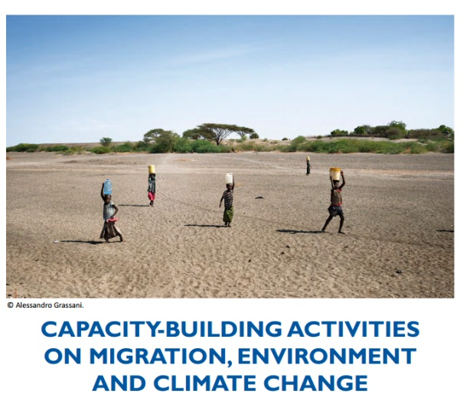
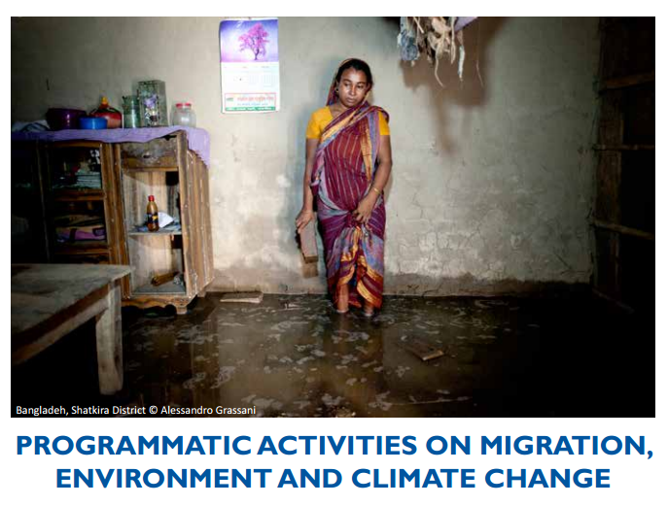
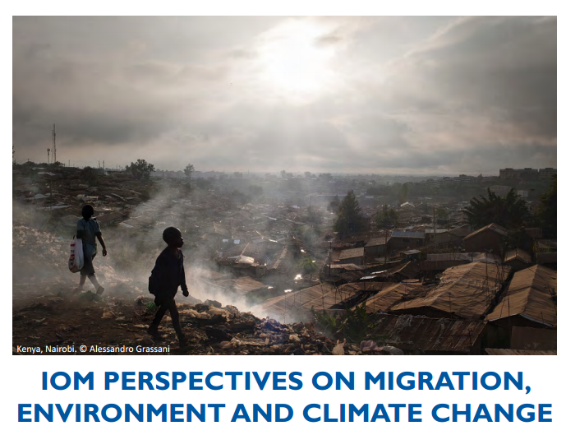
Iniciativas de OIM
División de migración, ambiente y cambio climático desde enero 2015
Notes:
New MECC division at IOM
For more on MECC activities, see: http://www.iom.int/cms/envmig

Slide 15
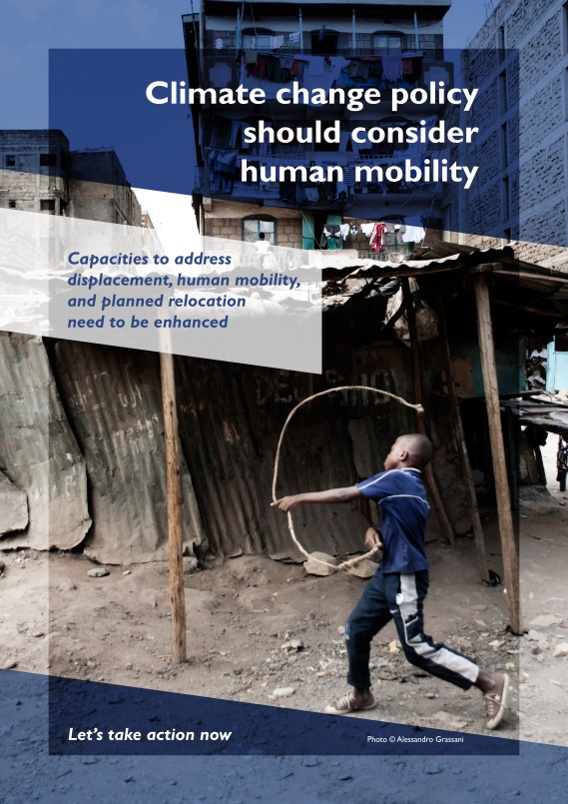
Iniciativas de OIM
Transversalización de la migración en procesos clave
  Negociaciones sobre clima
  Desarrollo de ODGs
  RRD (Marco de acción de Hyogo)
  Cumbre Humanitaria
Notes:
Climate negotiations
climate issues must be part of migration policy debates and human mobility considerations must be part of climate negotiations
IOM’s work within the UNFCCC framework since 2006, aims to engage with UNFCCC, states and partners to bring human mobility on the climate negotiations agenda and to position the organization as a key player on the management of climate induced migration
Example of IOM efforts: IOM actively contributed to a number of events at the 21st Conference of the Parties (COP20) climate change negotiations that took place in Lima, Peru in 2014
The development of the Sustainable Development Goals (SDG)
For more information, see: http://www.iom.int/cms/post2015
DRR (Disaster Risk Reduction) Hyogo Framework for Action 2005–2015: Building the Resilience of Nations and Communities to Disasters
The Hyogo Framework outlines five priorities for action, and offers guiding principles and practical means for achieving disaster resilience
Since the current Hyogo Framework for Action (HFA) has limited recognition of human mobility as a driver of risk, the post-2015 agreement on disaster risk reduction (DRR) (HFA2) must adequately recognize mobility as a fundamental human process that – although can increase risk – can also be central to building resilience.
Humanitarian Summit
IOM is contributing to processes and discussions in the lead up to the World Humanitarian Summit (WHS), scheduled for May 2016, in Istanbul, Turkey, with a view to ensure migration issues are featured in the Secretary General’s report to be published before the Summit.

Slide 16
Iniciativas de OIM
Objetivo de la Gestión Fronteriza Humanitaria (HBM):
  Mejorar la preparación y la respuesta para proteger a aquéllos que atraviesan las fronteras durante las emergencias, así como mantener la seguridad de las fronteras.
Notes:
Objective of IOM’s HBM:
Humanitarian Border Management (HBM) activities seek to improve preparedness and responses to protect those who cross borders in emergencies, as well as to ensure that the security of the border is maintained
http://www.iom.int/files/live/sites/iom/files/What-We-Do/docs/IBM-Factsheet-HBM.pdf
IOM can provide support in a number of capacities related to HBM:
Assessments on HBM capacities; • Delivery of HBM training for border officials; • Drafting or review of Standard Operating Procedures (SOPs) for emergencies; • Initiation of and improvement to emergency preparedness and contingency plans; • Establishment of a referral system to assist migrants and provide humanitarian relief; • Creation of interagency cooperation mechanisms to allow for a more coherent response to crises; • Design and procurement of mobile communication and registration technology solutions; etc.
For more on HBM activities: http://www.iom.int/files/live/sites/iom/files/What-We-Do/docs/IBM-Factsheet-HBM.pdf
IOM also has general immigration and border management (IBM) activities:
IBM activities are directed at helping governments create policy, legislation, administrative structures, operational systems and the human resource base necessary to respond effectively to diverse migration and border challenges and to institute appropriate migration governance.
For more on IBM activities, see: http://www.iom.int/cms/tcm

Slide 17
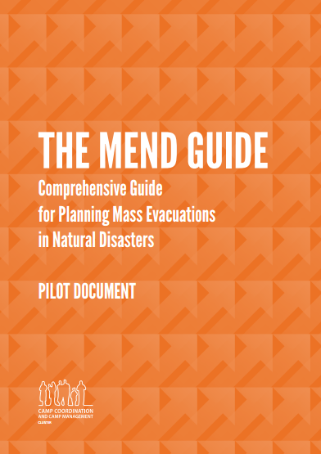
Iniciativas de OIM
OIM es la agencia líder del Grupo encargado de la coordinación y la gestión de campamentos (CCCM) en el contexto de respuestas a desastres naturales.
La Guía MEND
  Provee un formato para ayudar a crear y desarrollar planes nacionales de evacuación
Notes:
IOM is the global cluster lead for camp management and camp coordination (CCCM) in natural disasters
The goal of the CCCM Cluster:
improve living conditions of internally displaced persons by facilitating the provision of protection/services in camps and camp-like settings
advocate for durable solutions
ensure organized closure and phase-out of camps upon the IDPs’ relocation, return, resettlement or local integration.
CCCM gathers, monitors and disseminates information on population needs as well as on displacement patterns and dynamics throughout the crisis
CCCM cluster is cross-sectoral: it facilitates the coordination of services in response to the assistance and protection needs of IDPs in camps and camp-like situations.
Co-lead for the CCCM Cluster: United Nations High Commissioner for Refugees (UNHCR)
For a list of other partners: http://www.globalcccmcluster.org/about-us/our-partners
For more on CCCM, see: http://www.globalcccmcluster.org/system/files/publications/CCCM%20Brief_052012.pdf
The Comprehensive Guide for Planning Mass Evacuations in Natural Disasters (MEND guide):
A gap exists in the availability of relevant tools to guide national disaster management agencies as well as humanitarian actors in planning for mass evacuations
The MEND Guide contains a template to help create and develop national evacuation plans.
The collaboration on the MEND Guide brought together best practices and knowledge of experts in the field of disaster management and humanitarian aid.
Guidelines for the workshop: “[113] RCM Governments should thus seek ways to facilitate and encourage migrants’ access to emergency protection and assistance in disaster contexts”
“[126] The Government of each RCM State should consider preparing for the eventuality of renewed and increased humanitarian protection challenges as a result of disasters overseas by:
[…]
Revising, updating or adopting national, provincial and local emergency plans […]”

Slide 18
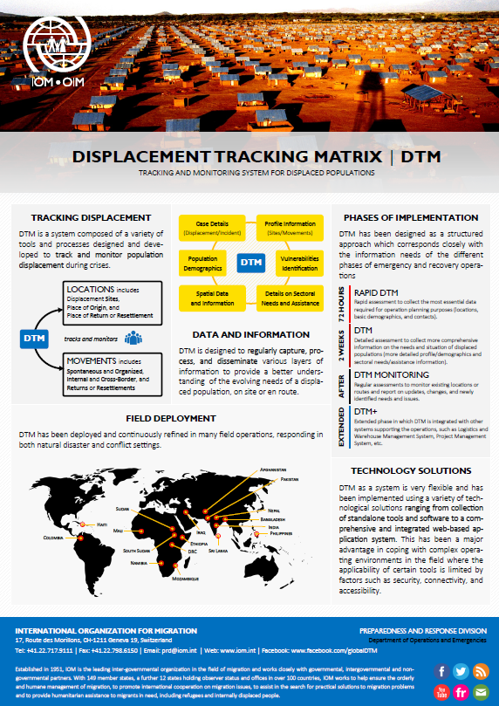
Iniciativas de OIM
Entender la vulnerabilidad por medio de la recolección de datos en situaciones de desplazamiento
Matriz de seguimiento de desplazados (DTM)
  Captura la evolución de los números y flujos de personas desplazadas.
Notes:
We must collect data in order to better understand vulnerabilities
The DTM is a Camp Coordination and Camp Management (CCCM) cluster tool developed by IOM
The DTM is designed to collect information at regular intervals, thereby providing a series of “snapshots” that allow to capture the evolution of the displaced persons’ numbers, flows and conditions where they have temporarily settled.
The DTM is implemented by supporting national and local partners in countries facing internal displacement in the aftermath of disasters
Find the infosheet here: http://www.iom.int/files/live/sites/iom/files/What-We-Do/docs/DOE-Infosheet-DTM-v2-1.pdf
Background study for the workshop (by DJ Cantor)
“The data on human mobility in the context of rapid-onset disasters caused by natural hazards in the Americas is decidedly fragmentary and lacking in detail”
Guidelines:
“[126] The Government of each RCM State should consider preparing for the eventuality of renewed and increased humanitarian protection challenges as a result of disasters overseas by:
[…] Revising, updating or adopting a process for collecting information about disasters and their humanitarian protection impact […]”

Slide 19

MCOF – Herramienta de Planificacion Estrategica para una Respuesta a la Movilidad Humana en Situacion de Crisis
Concepto
Crisis Migratoria: Flujos migratorios complejos-movilidad-vulnerabilidad
Perspectiva
Intersectorial Practica
Enfoque
Integral:Analiza tipo e intensidad de la crisis
Combina sectores humanitarios tradicionales y no tradicionales
Implementacion
Pilares: 1) Fases (antes, durante y despues)
2) Sectores de Asistencia (15)
3) Vinculos con sistemas de respuesta
Notes:
Nota: situaciones y condiciones no aliviadas: por ejemplo cambio climatico, actividades criminales, etc.
Crisis migratoria – es la descripcion de los flujos migratorios complejos y los patrones de movilidad humana a consecuencia de la crisis y eso trae considerables vulneraibilidades para las personas y poblaicones afectadas.
Cooperacion con socios involucrados en actividades de paz, seguridad y desarrollo.

Slide 20
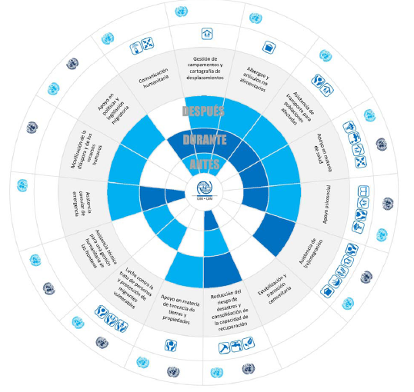
Diagrama de los Sectores: 15 sectores.
Sector 8 – reduccion de riesgo de Desastre y construccion de la Capacidad de recuperacion
Sector 11 – asistencia tecnica para una gestion humanitaria de las fronteras

Slide 21
Sectores 8 y 11 – Movilidad Humana en Crisis causados por fenomenos naturales en contexto internacional
Crisis: poblaciones afectadas
Movimiento transfronterizo de migrantes no protegidos internacionalmente
Capacidad de gestion de las fronteras
Fortalecimiento institucional
Para encarar las causas de vulnerabilidad a las amenazas naturales
Asistencia emergencia consular: ejem. Ind. Biometrica
Medidas de proteccion contra el trafico humano
Para mejorar la capacidad de recuperacion ante la crisis

Slide 22
MCOF: Despues de 1 ano de capacitacion
21 OR y Paises de la OIM capacitados.
32 gobiernos (ministerios) capacitados.
12 eventos para ONGs Nac./Int.
6 paises integraron el MCOF en sus estrategias nacionales.
Notes:
Nota: situaciones y condiciones no aliviadas: por ejemplo cambio climatico, actividades criminales, etc.
Crisis migratoria – es la descripcion de los flujos migratorios complejos y los patrones de movilidad humana a consecuencia de la crisis y eso trae considerables vulneraibilidades para las personas y poblaicones afectadas.
Cooperacion con socios involucrados en actividades de paz, seguridad y desarrollo.

Slide 23
MCOF – Lecciones Aprendidas
Ayuda al entendimiento holistico de las implicaciones de la movilidad humana versus proteccion y asistencia de las perosnas afectadas.
Puede ser adaptado a las condiciones y contextos nacionales.
Identifica situaciones y condiciones que no fueron aliviados conduncentes a una crisis migratoria.
Promueve cooperacion con socios involucrados: Paz, Seguridad y Desarrollo.
Es util para los responsables en formulacion de politicas (profesionales y autoridades del gobierno).
Notes:
Nota: situaciones y condiciones no aliviadas: por ejemplo cambio climatico, actividades criminales, etc.
Crisis migratoria – es la descripcion de los flujos migratorios complejos y los patrones de movilidad humana a consecuencia de la crisis y eso trae considerables vulneraibilidades para las personas y poblaicones afectadas.
Cooperacion con socios involucrados en actividades de paz, seguridad y desarrollo.

Slide 24
Organización Internacional para las Migraciones
Muchas gracias

