Slide 1
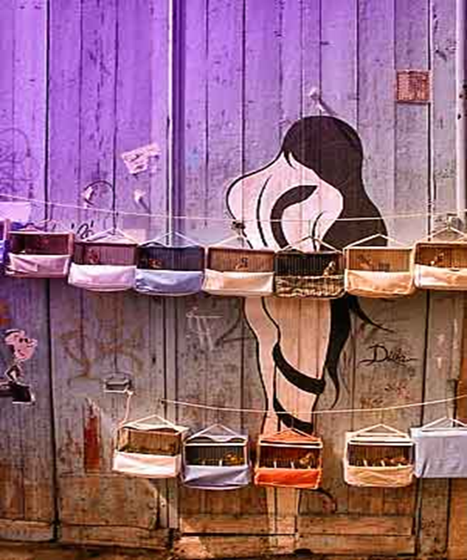
Human Rights and Trafficking of Women
Presented by:
Toribia Venado V.
June 20, 2012

Slide 2
Human Rights of Women Victims of Trafficking in Persons
We recognize the actions implemented by the international and national community to combat this crime.
The establishment of INAMU in Panama represents a direct effort to guide, ensure, and represent the claims of women in regard to this topic.
Efforts are being projected in regional actions of the Council of Women’s Ministers of Central America and the Dominican Republic (COMMCA), ascribed to SICA.

Slide 3
Human Rights of Women Victims of Trafficking in Persons
COMMCA seeks to consolidate the gender approach at an institutional level in the Central American Integration System (SICA) and in addition, to incorporate gender equality.
The Strategic Plan 2009-2013 seeks to have a cross-cutting impact on all forms of violence affecting women and integrate this topic into security policy in the region, with the aim of resolving this issue and achieving that it is taken on by SICA at an institutional level.

Slide 4
Considerations relating to this Matter
Human rights violations of victims of trafficking in persons are serious. Most of them are young women (18-25 years old) and girls in danger. This situation has stimulated actions to address and combat this crime in the region.
Fundamental rights of women are violated. Despite relevant efforts the number of criminal actions is increasing, often as a result of the situation of poverty affecting women in their countries of origin.

Slide 5
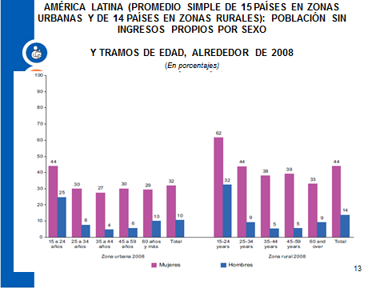
LATIN AMERICA (AN AVERAGE OF URBAN AREAS IN 15 COUNTRIES AND
RURAL AREAS IN 14 COUNTRIES):
POPULATIONS WITHOUT ANY INCOME OF THEIR OWN, BY GENDER
AND AGE GROUP, AROUND 2008
(Percentages)

Slide 7
TRAFFICKING ROUTES AND DESTINATIONS

Slide 8
Table 015. CRIMES AGAINST DECENCY AND SEXUAL FREEDOM RECORDED IN THE REPUBLIC OF PANAMA,
BY PROVINCE, BY TYPE: 2009.
Against Decency and Sexual Freedom | Provinces
 | Total |  | Bocas del Toro | Coclé | Colón | Chiriquí | Darién | Herrera | Los Santos | Panamá | Veraguas | Kuna Yala
 | No. | Percentage
TOTAL……...…..... | 1,801 | 100 | 57 | 38 | 232 | 138 | 6 | 9 | 17 | 1,295 | 9 | 0
Violación Carnal | 809 | 44.9 | 41 | 18 | 103 | 80 | 4 | 5 | 9 | 542 | 7 | -
Intento de Violación Carnal | 175 | 9.7 | 9 | 8 | 27 | 9 | 1 | 1 | 4 | 116 | - | -
Acoso Sexual | 82 | 4.6 | - | 1 | 14 | 5 | - | - | - | 61 | 1 | -
Actos Libidinosos | 268 | 14.9 | 3 | 3 | 35 | 13 | 1 | 2 | 1 | 210 | - | -
Rapto | 1 | 0.1 | 1 | - | - | - | - | - | - | - | - | -
Estupro | 286 | 15.9 | 2 | 4 | 29 | 13 | - | 1 | 3 | 234 | - | -
Pornografia con Menores | 21 | 1.2 | - | - | 3 | - | - | - | - | 18 | - | -
Rufianismo | 0 | 0.0 | - | - | - | - | - | - | - | - | - | -
Relaciones Sexuales Remuneradas | 42 | 2.3 | - | - | 21 | - | - | - | - | 21 | - | -
Turismo Sexual | 1 | 0.1 | - | - | - | - | - | - | - | 1 | - | -
Proxenetismo | 7 | 0.4 | - | - | - | - | - | - | - | 7 | - | -
Trata Sexual | 11 | 0.6 | - | - | - | 1 | - | - | - | 10 | - | -
Corrupción de Menores | 98 | 5.4 | 1 | 4 | - | 17 | - | - | - | 75 | 1 | -
(-) Zero.
Source: Prepared by SIEC, based on information provided by the National Police Force and the Directorate of Judicial Investigation.

Slide 9
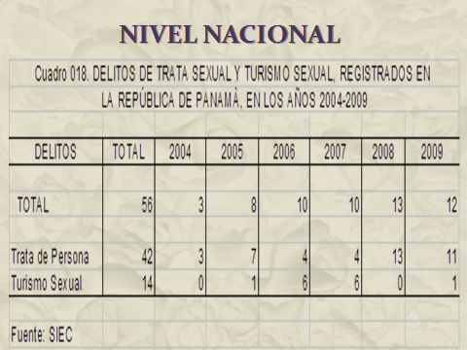
AT A NATIONAL LEVEL

Slide 10
National Strategies Against Trafficking in Persons
National Committee to Prevent Crimes of Sexual Exploitation (Act No.16, 2004);
Establishment of PPIOM by INAMU;
Act No.79, 2011against Trafficking in Persons and Related Actions (MINSEG).

Slide 11
INAMU: Public Policy, Central Theme of Trafficking
To promote legal actions oriented toward controlling trafficking in persons;
To establish mechanisms for inter-institutional exchange and collaboration to ensure assistance for victims of trafficking;
To promote awareness-raising efforts and changes in the attitude of technical staff addressing the topic.

Slide 12
Final Observations of CEDAW
Session No. 45 of the CEDAW Committee, January 18, 2010.
Concerns of CEDAW: Expect results from the 2014 Report in regard to actions adopted to address concerns, as well as formulated recommendations.
Due to the high prevalence of domestic violence against women, lack of protection for victims, denouncement mechanisms, and campaigns to educate women about their rights.

Slide 13
Final Observations of CEDAW
Concern regarding the number of women and girls that have been victims of trafficking and the reduced number of perpetrators that have been prosecuted and punished.
Absence of data on women and girls victims of trafficking and sexual exploitation.
The Committee recommends to strengthen efforts to combat all forms of trafficking of women and girls, to punish and prosecute traffickers, guaranteeing protection of the human rights of women and girls victims of trafficking.

Slide 14
Final Observations of CEDAW
The Committee requests that support for women and girls victims of trafficking is ensured to enable them to testify against traffickers without fear.
During the next regular review we should provide information about the multiple forms of discrimination and violence against women in different spheres – public and private.

Slide 15
Wake up!
Trafficking in Persons
Really Exists.
FIND OUT MORE ABOUT IT.
INFORMATE

