Slide 1
United States’ Regional Efforts on Migration Management
Regional Conference on Migration
June 2012
Panama City, Panama

Slide 2
Overview
Supporting RCM Member Countries Through:
Advocating for Humane Migration Management Practices and Sustainable Solutions for Refugees, Victims of Conflict, Vulnerable Migrants, and Stateless Persons
Presented by U.S. Department of State/Bureau of Population, Refugees, and Migration (PRM)
Foreign Assistance Programs
Presented by U.S. Department of State/Bureau of Western Hemisphere Affairs (WHA)
Operational and Technical Support
Presented by U.S. Department of Homeland Security/Office of International Affairs (OIA)

Slide 3
PRM Overview
What is PRM?
P
R
M

Slide 4
PRM Priorities in the Region
Aid and sustainable solutions for refugees, victims of conflict, vulnerable migrants, stateless persons
Repatriation, local integration, resettlement in the US, basic humanitarian assistance
Particular attention to urban refugees (70% of Western Hemisphere refugees)
Work with UNHCR and governments to improve refugee status determinations
Work with IOM and governments on humane migration management

Slide 5
PRM Assistance
PRM Assistance to Colombian IDPs and Refugees
Over 400,000 Colombians seek international protection in neighboring countries
$39.5 million in FY 2011 to protect/assist Colombian IDPs and refugees
Programs in Costa Rica, Panama, Ecuador, and Venezuela
emergency humanitarian assistance
capacity building for interested governments and civil society

Slide 6
PRM Assistance
PRM Assistance in Haiti
Approximately 421,000 Haitian IDPs
PRM supports:
Gender-based violence prevention
Advocacy for civil registry reform
Repatriation on the Northwest Coast of Haiti
Assisted voluntary return from Dominican Republic

Slide 7
PRM Regional Migration Program
Mexico and Central America
IOM-implemented program to protect vulnerable migrants through capacity-building of governments, civil society, and NGOs
Training and regional guidelines for assisting vulnerable migrants
Support RCM and counter-trafficking initiatives:
Regional guidelines on identification and referral
Support to national counter-trafficking coalitions
Workshops on migrant women , LGBT migrants
Meetings on extra-continental migration

Slide 8
WHA: A Strategy for the Americas
1. Citizen Security for All
Merida, Caribbean Basin Security Initiative (CBSI), Central American Regional Security Initiative (CARSI), Colombia (CSDI)
2. Effective Democratic Institutions
Inter-American Democratic Charter, Summit of the Americas, Human Rights
3. Social and Economic Opportunity
Pathways to Prosperity, Social Inclusion, Free Trade Agreements, U.S. – Brazil Joint Action Plan
4. Secure and Clean Energy Future
Global Climate Change Initiative (GCCI), Energy and Climate Partnership of the Americas (ECPA)

Slide 9
Security Partnerships
Objectives
Comprehensive
Balanced
Partnership
Shared Responsibility
Security Initiatives
Central American Regional Security Initiative
The Merida Initiative
Caribbean Basin Security Initiative
Colombia
Notes:
These objectives are critical; without them, our security initiatives will not work.

Slide 10
Central America Regional Security Initiative
Launched in 2008 as part of the Merida initiative for Central America – formally designated as CARSI in 2010; almost $500M in total US assistance allocated
Five Pillars of CARSI
Create safe streets for the citizens of the region;
Disrupt the movement of criminals and contraband within and between the nations of Central America;
Support the development of strong, capable and accountable Central American Governments;
Re-establish effective state presence and security in communities at risk; and
Foster enhanced levels of security and rule of law coordination and cooperation between the nations of the region

Slide 11
The Merida Initiative
Unprecedented partnership between the United States and Mexico to fight organized crime and associated violence while furthering respect for human rights and the rule of law. $1.9 billion appropriated by Congress since FY08; Just over $1 billion delivered to date
Four Pillars of the Merida Initiative:
I. Disrupt Organized Criminal Groups
Aviation to increase air mobility; anti-money laundering/asset forfeiture; special and vetted units; security equipment; satellite communications.
II. Strengthen Institutions
Law enforcement professionalization; institutional building and rule of law; prisons; prosecutorial capacity building; trustworthy institutions; forensics.
III. Build a 21st Century Border
Non-intrusive inspection equipment (NIIE); canines; biometric immigration systems.
IV. Build Strong and Resilient Communities
Demand reduction; culture of lawfulness; USAID programs.

Slide 12
Citizen Security & Migration
Combats Smuggling and Trafficking
Prevents Family Uprooting and Separation
Protects Migrants
Creates Space for Economic Development and Growth
Notes:
Combats Smuggling and TIP: With the proper security infrastructure in place, law enforcement and the courts can combat these crimes effectively, making it more difficult for traffickers and smugglers to exploit vulnerabilities.
Family Separation: Secure communities prevent the major “push” factors of migration, such as violence, which breaks up families and separates children from their parents.
Migrant Protection: Security will not stop migration, but it will create environments where migrants can travel safely without fearing exploitation and violence.
Economic Development and Growth: Secure environments create conditions where business and investment has a fighting chance, creating a ripple effect of job growth and economic development.

Slide 13
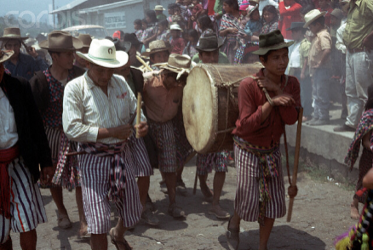
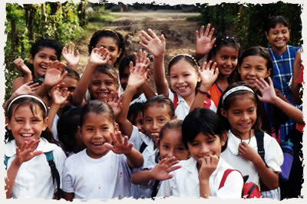
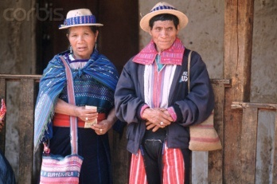
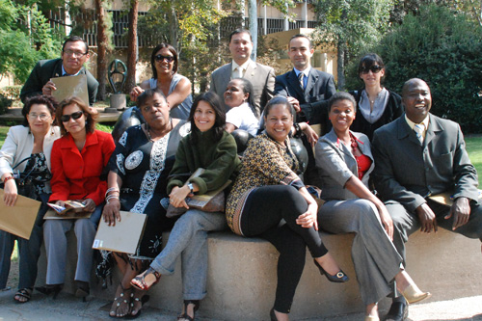
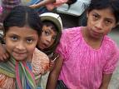
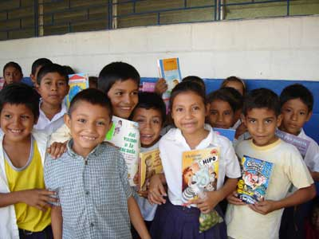
Partnership and Proximity
Creating Prosperity and Progress in the Americas
Notes:
Partnering to advance mutual interests and promote economic prosperity, citizen security, social inclusion, human rights, and strong democratic institutions.
Using the power of proximity to create opportunities and realize the potential of all peoples of the Americas.

Slide 14
DHS Regional Strategy
Facilitate the Secure Flow of Legitimate Trade and Travel
Support a Secure Supply Chain
Deny, Degrade, and Dismantle Transnational Criminal Organizations
Enhance Border Security
Provide Border Management Support
Support White House Transnational Organized Crime Strategy

Slide 15
DHS Strategic Framework
ICE Illicit Pathways Attack Strategy (IPAS)
Work with partners to investigate, identify, disrupt, and dismantle transnational organized crime (TOC) syndicates in the Western Hemisphere.
Prioritize networks and pathways posing the greatest threats
Maintain robust interagency engagement
Coordinate a regional approach that leverages partners

Slide 16
Regional Trends – South Asia
Significant decrease along the SWB since August 2011
Slight shift in encounters from South Texas to Arizona

Slide 17
Regional Trends – South Asia

Slide 18
Regional Trends – East Africa

Slide 19
DHS Anti-Trafficking Initiatives
DHS Blue Campaign
The Blue Campaign coordinates and enhances DHS’s anti-human trafficking efforts
Resources include:
Training
Informational Videos and Materials
Public Awareness Campaigns
Victim Assistance and Perpetrator Justice
Partnerships and Collaboration
www.dhs.gov/humantrafficking
No Te Engañes
CBP campaign to raise awareness of the dangers of human trafficking
Notes:
Training: The Blue Campaign created training for many audiences including the public, law enforcement, airline personnel, the U.S. Government acquisition workforce, DHS personnel, and domestic and foreign partners. The trainings are available at www.dhs.gov/humantrafficking.
Informational Videos and Materials: The Blue Campaign created wallet-sized indicator cards, indicator pamphlets, indicator posters, a brochure about Continued Presence, brochures and fact sheets with immigration relief information for victims, a pamphlet targeted toward the faith-based community, and videos to help educate first responders and the general public about human trafficking. These materials are available electronically at www.dhs.gov/humantrafficking and in hard copy (where applicable) via a request form on the web site.
Public Awareness Campaigns: The Blue Campaign created several public awareness campaigns, including a video played on the CNN Airport Network in airports across the country, a U.S. Immigration and Customs Enforcement (ICE) campaign to help the public identify victims called Hidden in Plain Sight, and a U.S. Customs and Border Protection (CBP) campaign to inform migrants of the dangers of human trafficking.
Victim Assistance And Perpetrator Justice: The Blue Campaign helped coordinate the Department’s efforts to enhance the ability to serve victims by assigning victim specialists to ICE Special Agent in Charge offices across the country, increasing the number of ICE forensic interviewers, increasing U.S. Citizenship and Immigration Services (USCIS) victim confidentiality provisions, and creating CBP victim-centered materials. ICE continues to prioritize the investigation of human trafficking cases. In fiscal year 2011, ICE initiated more than 700 human trafficking investigations, which resulted in more than 930 arrests, 400 indictments, and 270 convictions.
Partnerships And Collaboration: The Blue Campaign developed a toolkit for the private sector and distributed it to tens of thousands of employers, including those in the lodging, transportation, entertainment, agricultural, manufacturing, and construction industries. The Blue Campaign continues to engage with stakeholders in biannual public meetings.
--
No Te Engañes/Don’t Be Fooled is the voice of U.S. Customs and Border Protection in the global fight against human trafficking. CBP exposes human trafficking as the modern day manifestation of slavery with sexual exploitation and forced labor being the traffickers' main goal. The campaign has two very distinctive objectives and audiences based on geography.
The main objective of No Te Engañes for the International audience is to raise awareness amongst potential migrants, informing them of the dangers of human trafficking and help them avoid becoming a victim.
The objective of Don’t Be Fooled for the U.S. audience is to create awareness of the existence of the phenomenon in our own neighborhoods and to invite the community in key markets to join the fight against human trafficking by promoting a phone number where they can call to report any suspicious activity.

Slide 20
Immigration Protections for Victims of Crimes
U.S. law provides several protections for both legal and undocumented immigrants who have been victims of crime. There are specific protections for victims of domestic violence, victims of certain crimes, and victims of human trafficking which may include:
U or T Nonimmigrant Status
Violence Against Women Act (VAWA) Self-Petitioners
Special Immigrant Juvenile
Asylum Status
Any individual who has properly applied for asylum and is determined to be a refugee under the U.S. Immigration and Nationality Act (INA).
Benefits of Asylum Status
Can remain in the U.S. indefinitely, unless asylum status is terminated
Work authorization
Legal Permanent Resident status one year after asylum grant
Family reunification
Social security card
Notes:
U Visa:
Offers immigration protection for victims of certain crimes; Victims must obtain certification from law enforcement;
Victims get legal status and work authorization for 4 years; after 3 years can apply for lawful permanent residence
T Visa:
Provides immigration protection to victims of severe forms of human trafficking; Congress wanted to aid law enforcement in investigating and prosecuting human trafficking by providing a way for victims to remain in the US to assist in an investigation or prosecution;
Victims get legal status and work authorization for 4 years; after 3 years can apply for lawful permanent residence
VAWA Self Petitioners:
Provides immigration relief to victims of domestic violence; U.S. Congress recognized that immigrant victims of domestic violence may remain in an abusive relationship because immigration status is often tied to their abuser.
VAWA is a “self-petitioning” relief that removes control from the abuser & allows the victim to submit his or her own application that is filed without the abuser’s knowledge or consent.
Victims can be placed in deferred action to prevent removal from the US, can work in the US and can adjust status to lawful permanent residents
Special Immigrant Juvenile:
We will discuss this further during the DHS UAC presentation but to give a brief overview:
Provides immigration protection for alien juveniles in a state juvenile court system due to abuse, abandonment or neglect.
Relief includes immediate eligibility for adjustment of status to lawful permanent resident.

Slide 21
DHS Operational Initiatives
Advance Passenger Information/Joint Security Program at Tocumen International Airport (PTY)
A partnership between Panamanian law enforcement and DHS.
Places CBP officers and ICE/HSI special agents along side Panamanian law enforcement at PTY.
Transnational Criminal Investigative Units (TCIUs)
ICE’s TCIU Program enhances cooperation between ICE and host governments in order to identify, disrupt, and dismantle transnational criminal organizations that threaten regional stability.
TCIUs are multi-disciplined units comprised of prosecutors and immigration, law enforcement, customs, and intelligence officials.
Notes:
(PNP, Consejo de Seguridad Nacional, Servicio Nacional de Migracion, Autoridad Nacional de Aduanas, and Tocumen S.A.)

Slide 22
DHS Operational Initiatives
Support the Merida Initiative, CARSI, CBSI
DHS provides training and technical assistance to counterpart agencies through these Department of State foreign assistance programs.
Other Direct Bilateral Engagements
DHS works very closely with all hemispheric partners on a host of anti-crime, anti-gang, trade and travel facilitation, customs and immigration-related issues

Slide 23
Next Steps
Regional Coordination--Where to Focus our Efforts:
Common visa policies for the region
Region-wide API programs
Information sharing on trafficking networks and developing investigations that attack criminal networks
Robust prosecution of trafficking cases
Empowering immigration officials

Slide 24
Thank You
Questions?

